Slide 1
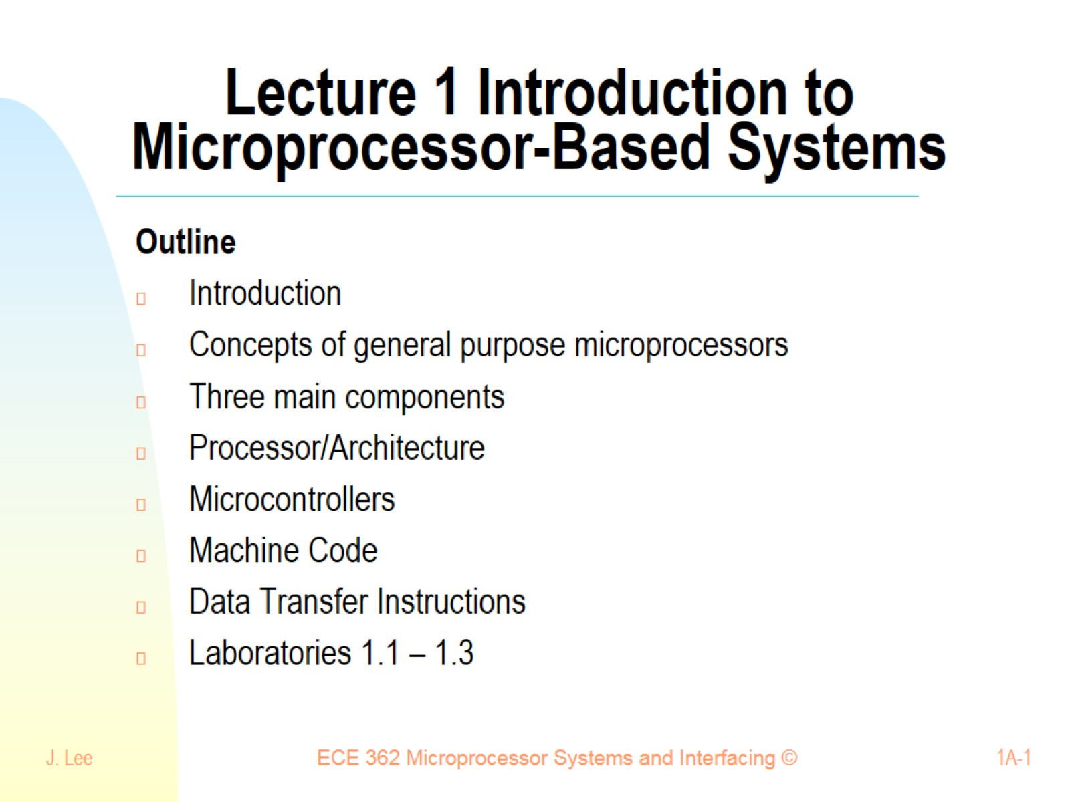
Lecture 1 Introduction to Microprocessor-Based Systems

Slide 2


Slide 3
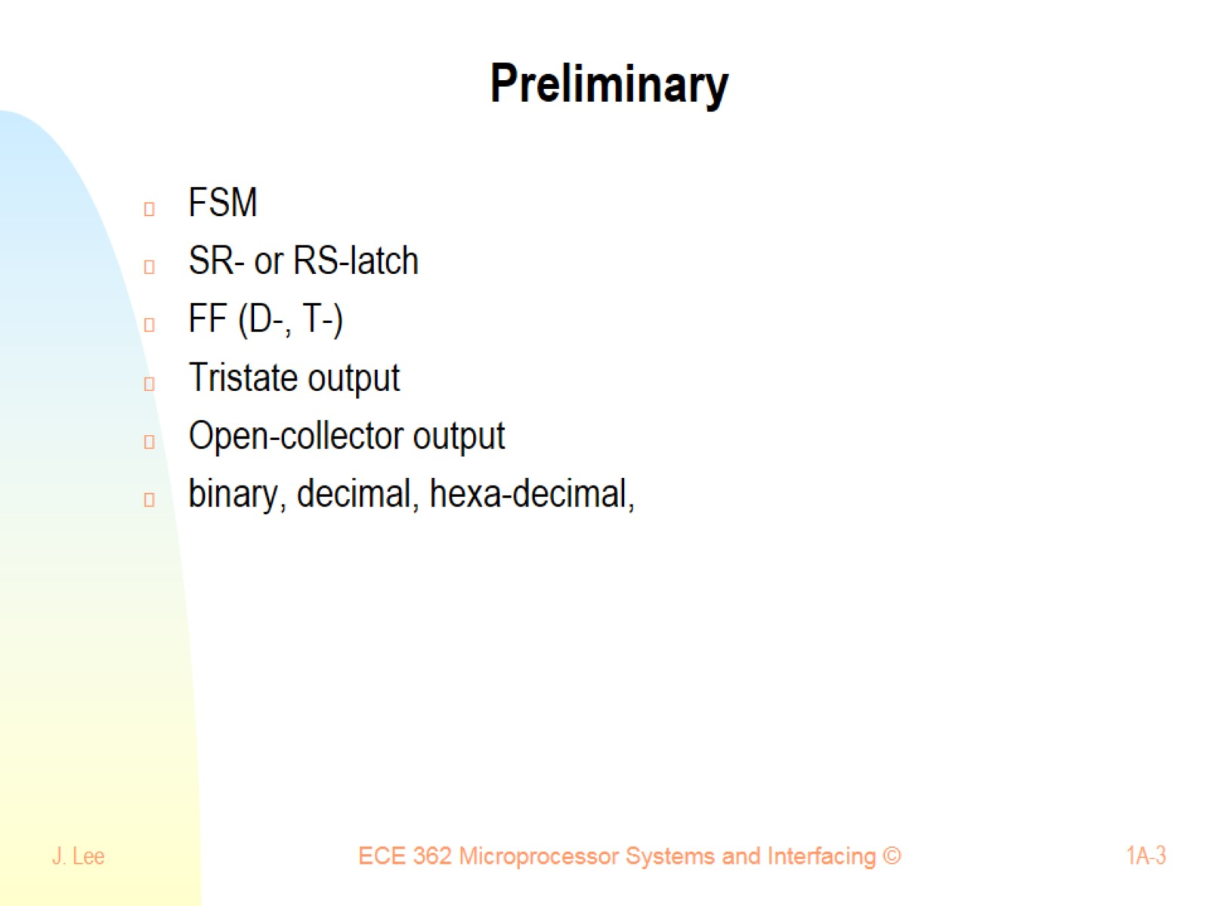
Preliminary

Slide 4
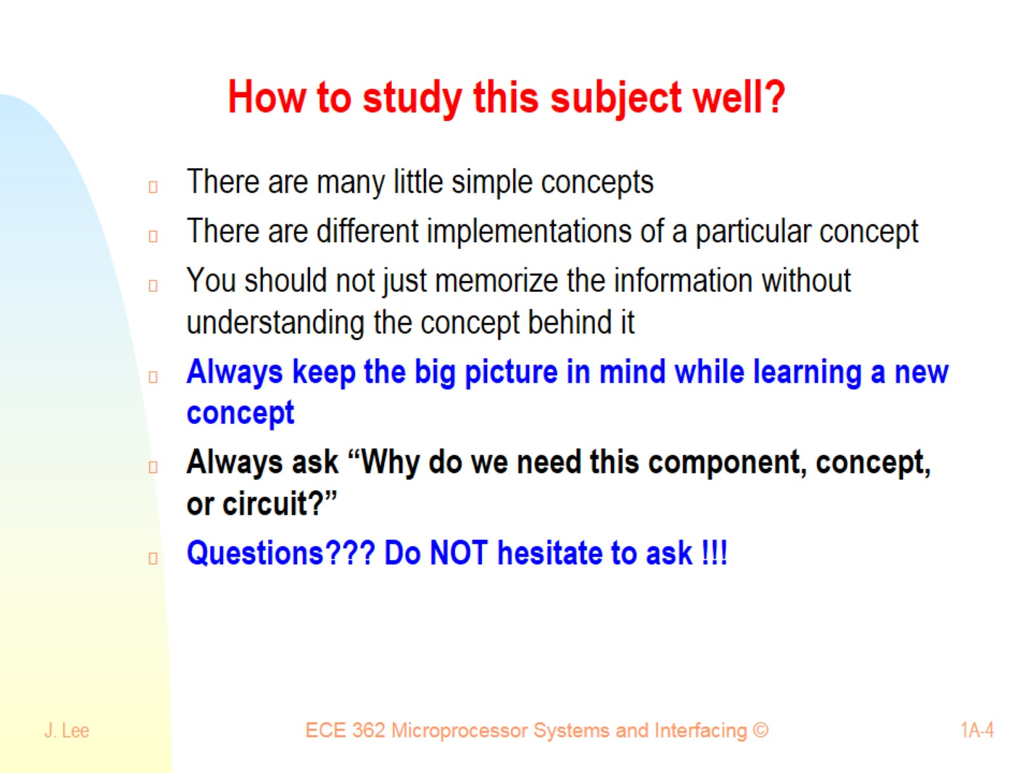
How to study this subject well?

Slide 5
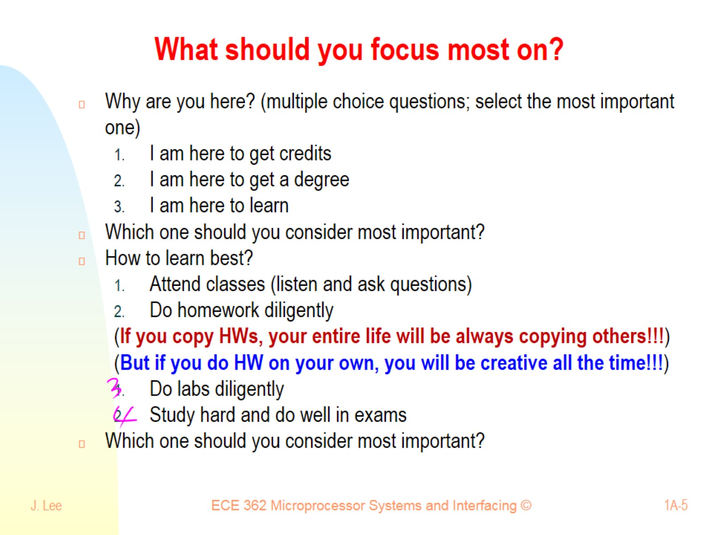
What should you focus most on?

Slide 6
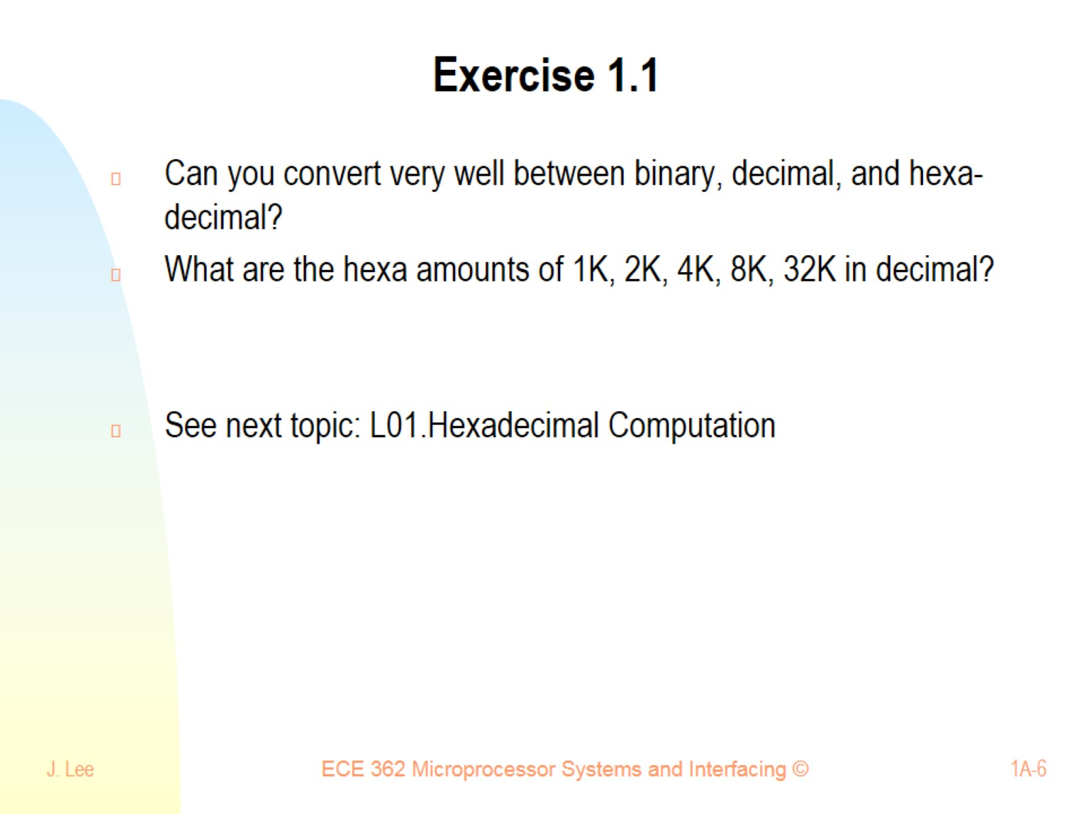
Exercise 1.1

Slide 7
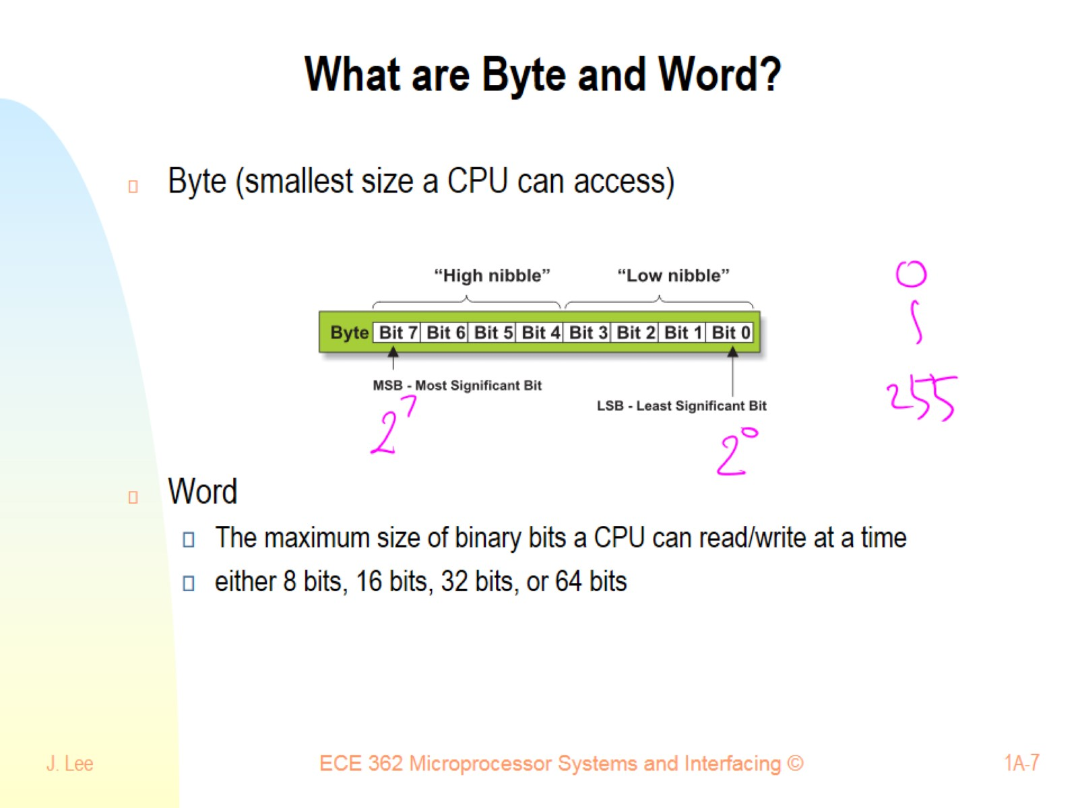
What are Byte and Word?

Slide 8
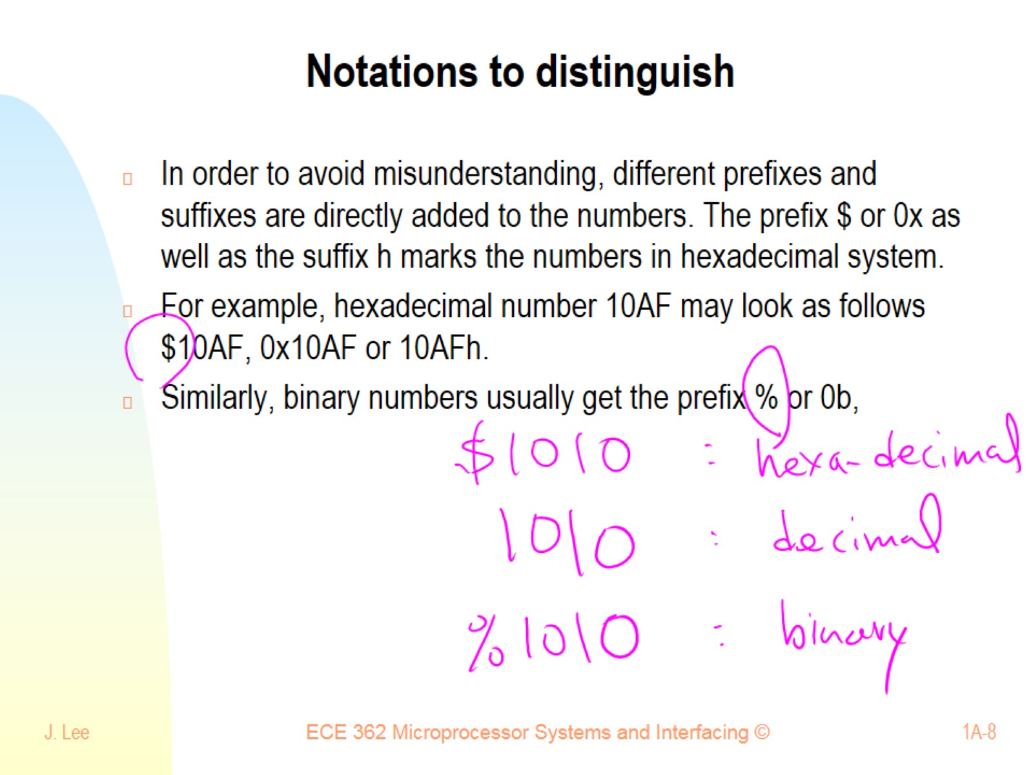
Notations to distinguish

Slide 9
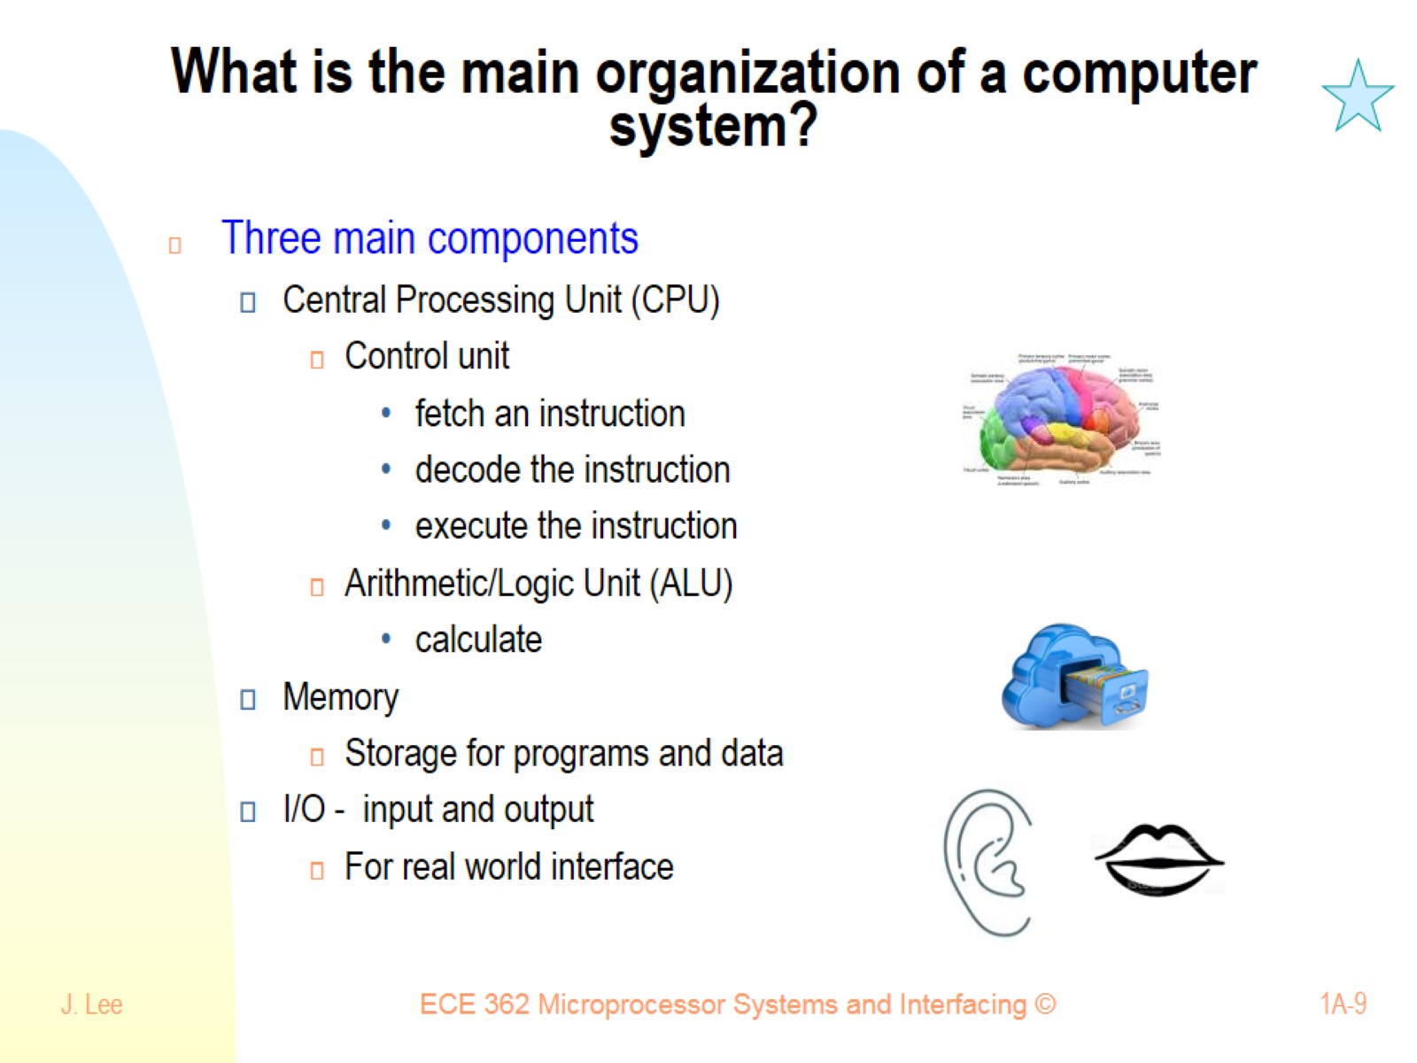
What is the main organization of a computer system?

Slide 10
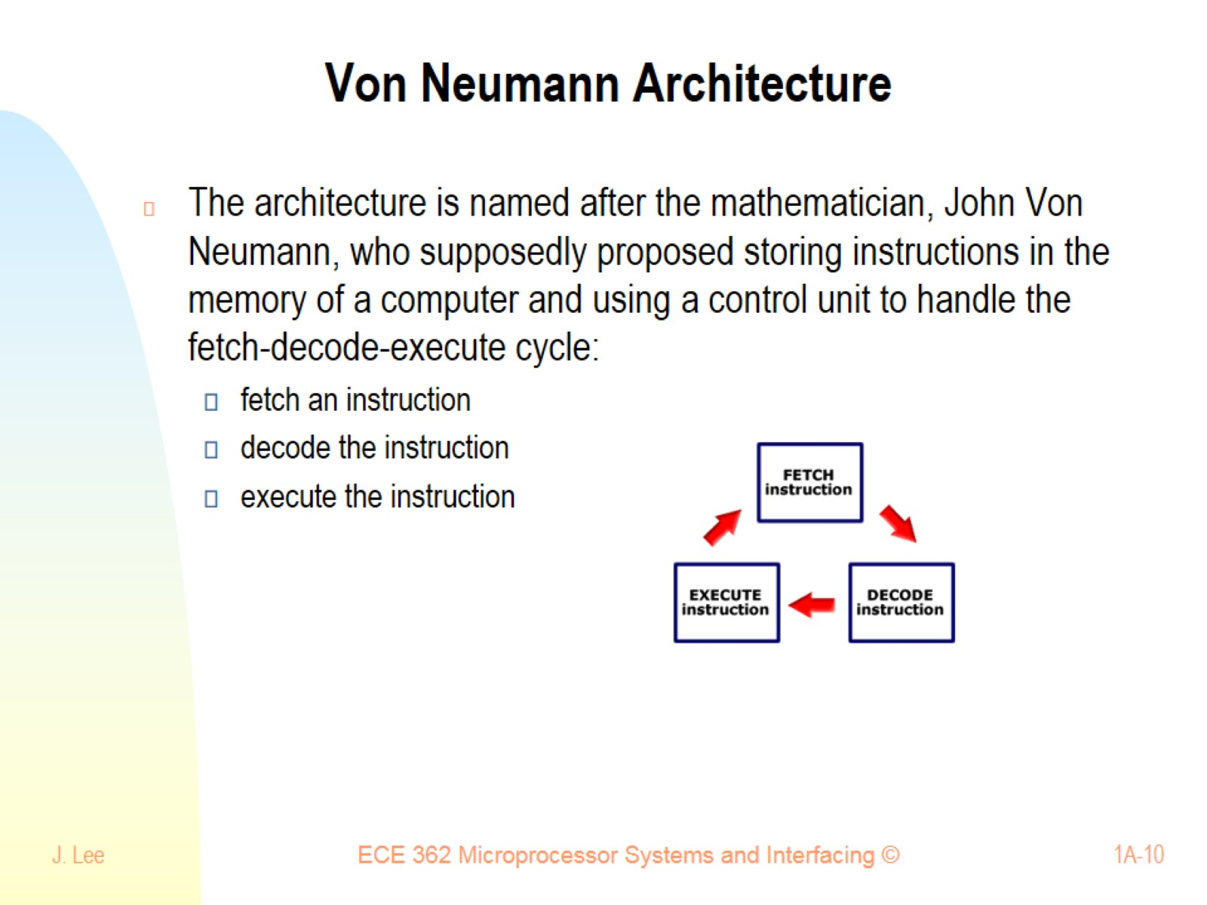
Von Neumann Architecture

Slide 11
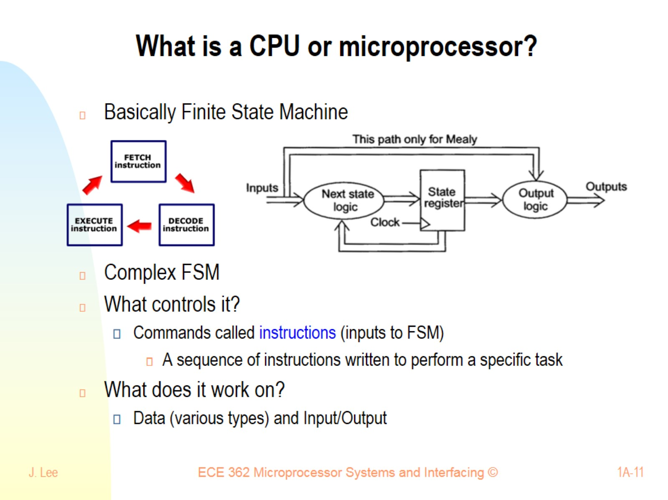
What is a CPU or microprocessor?

Slide 12
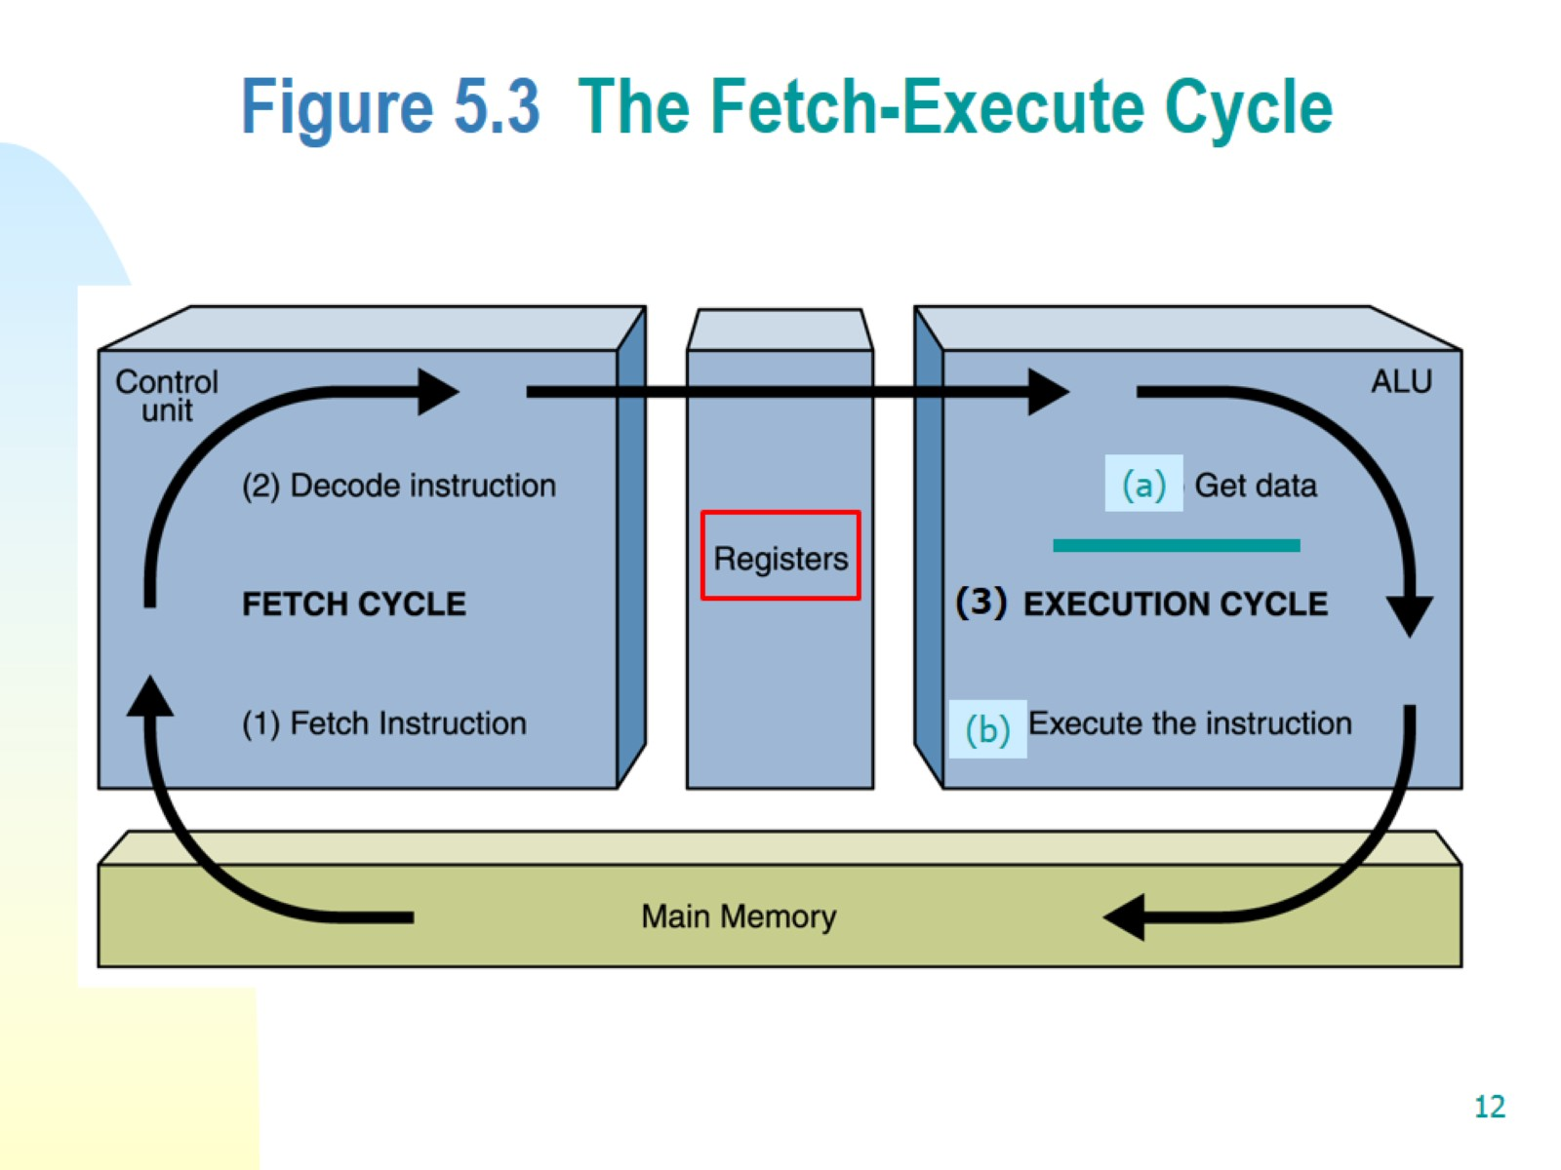
Figure 5.3 The Fetch-Execute Cycle

Slide 13
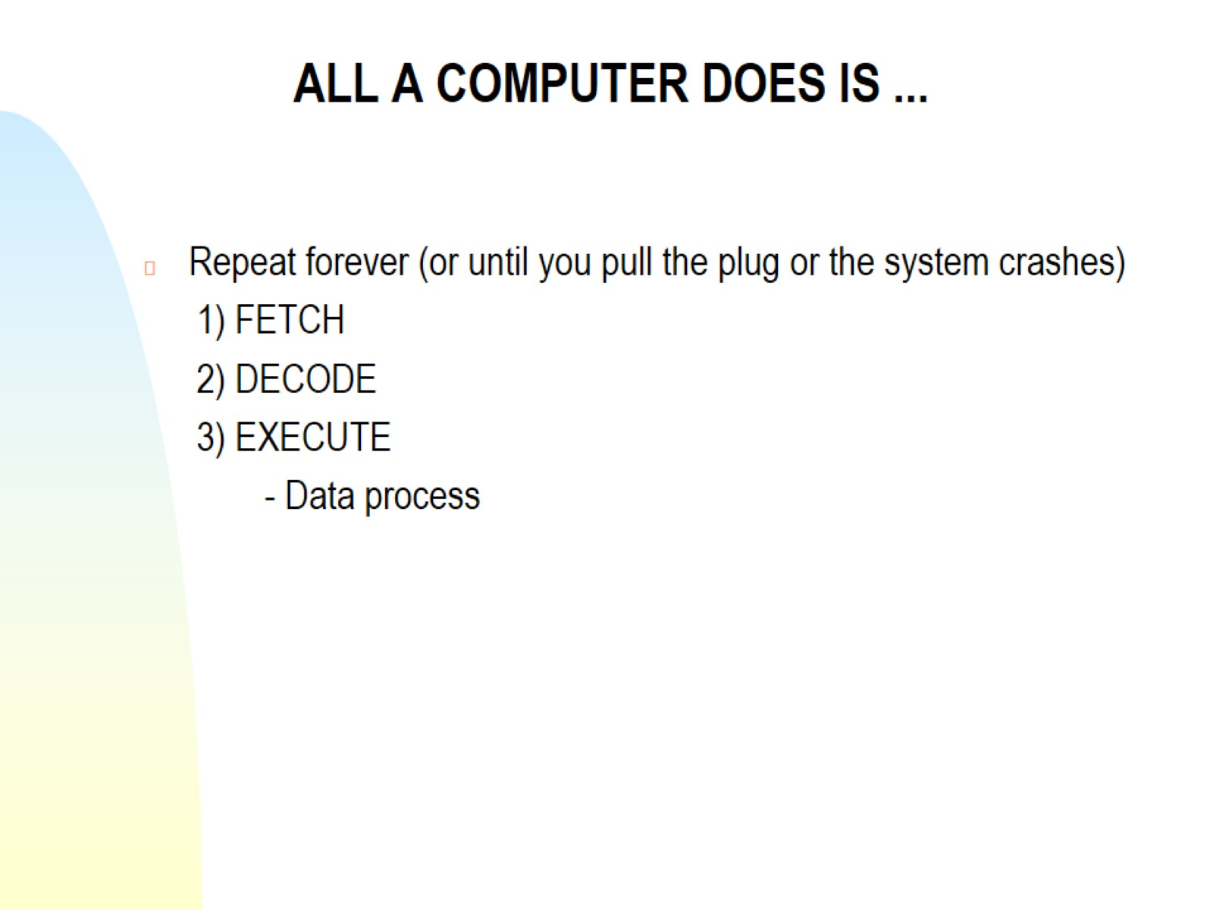
ALL A COMPUTER DOES IS ...

Slide 14
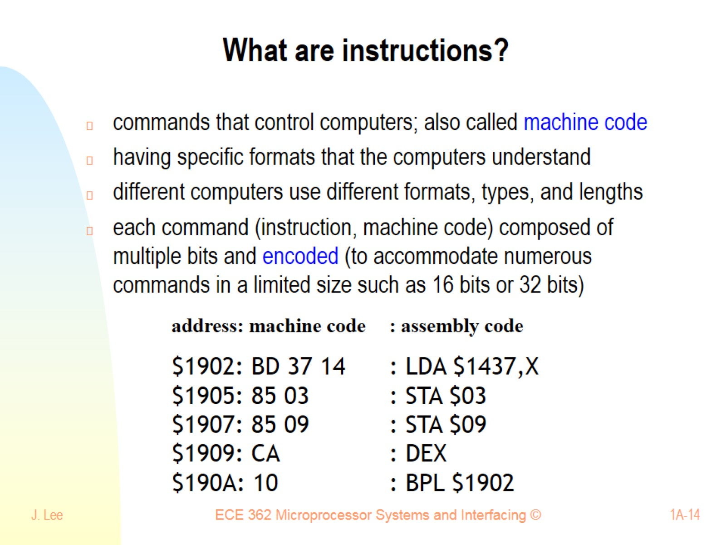
What are instructions?

Slide 15
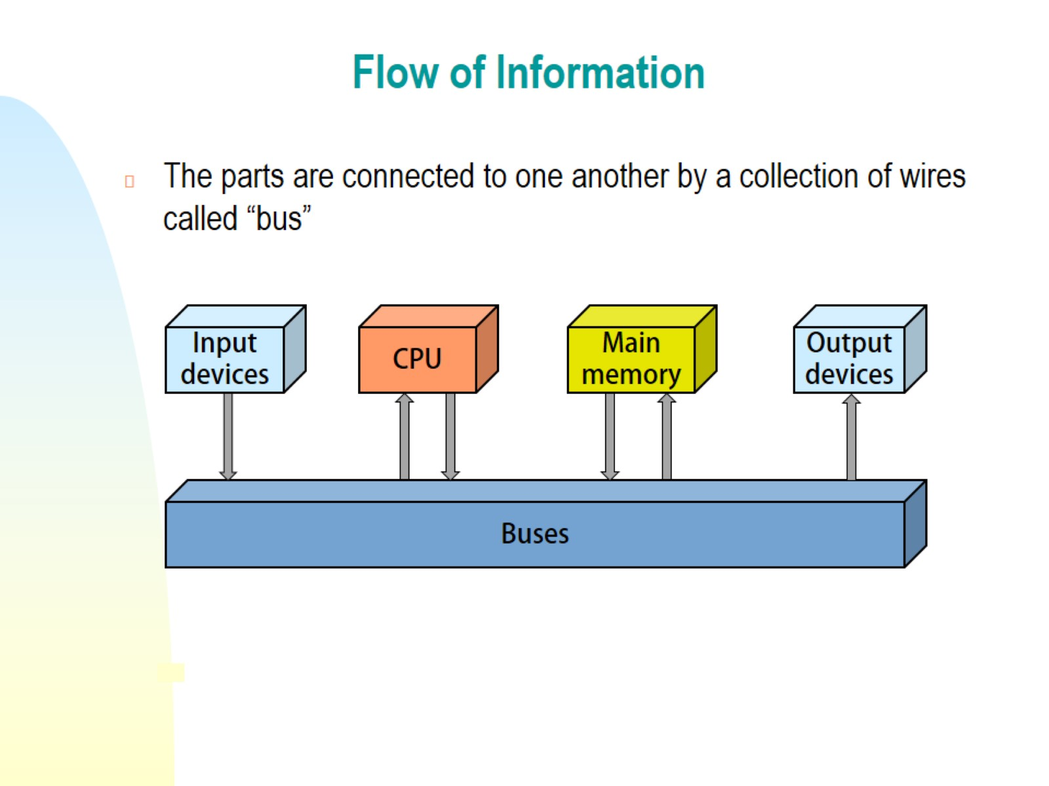
Flow of Information

Slide 16
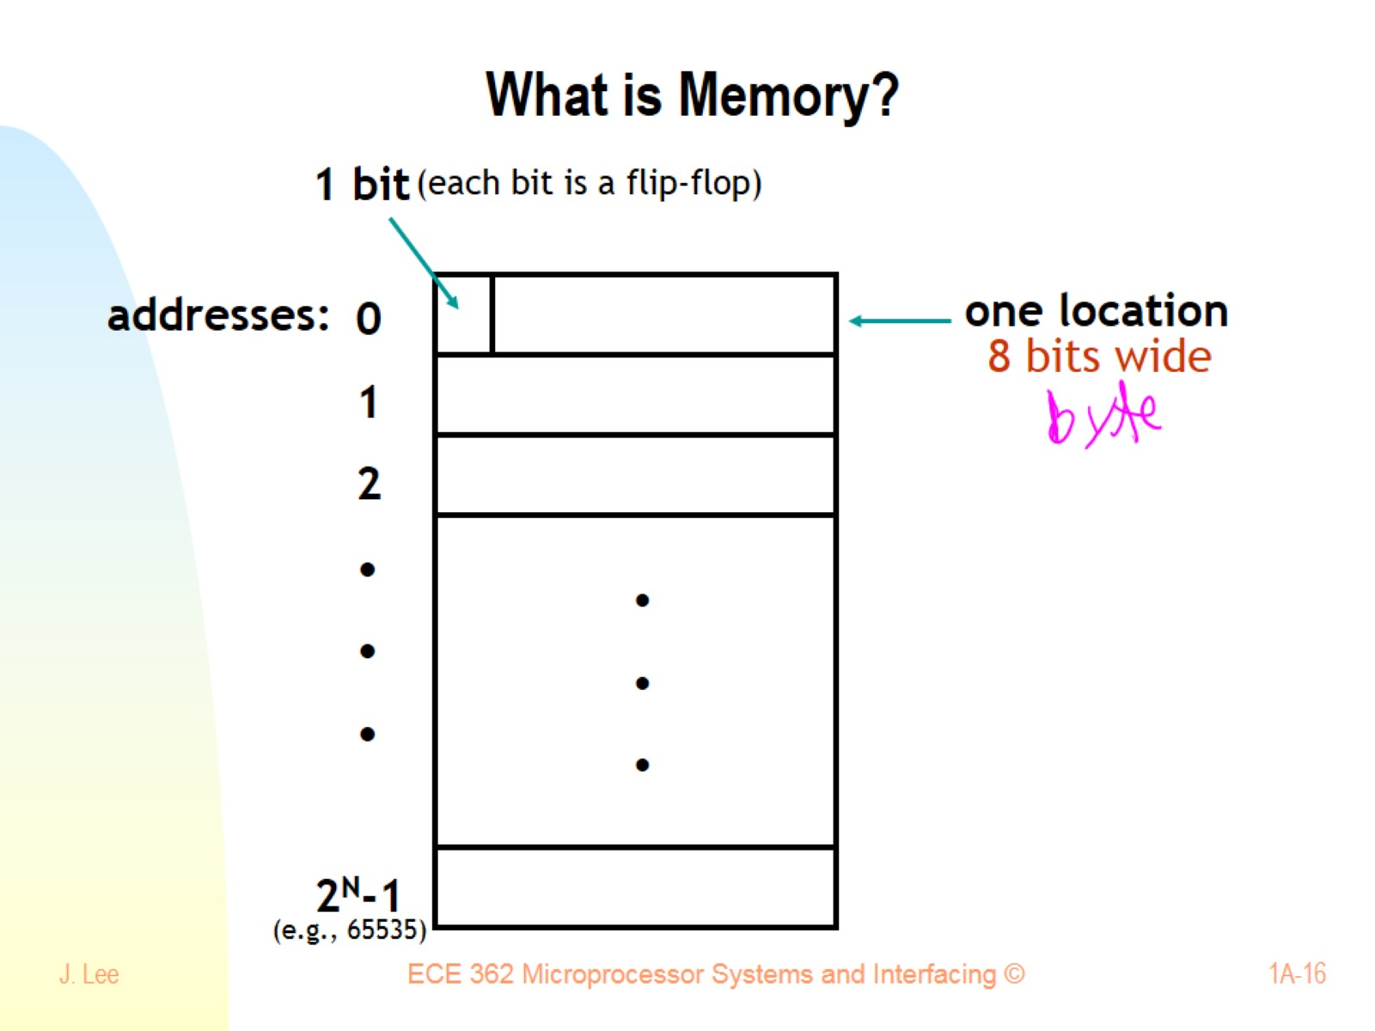
What is Memory?

Slide 17
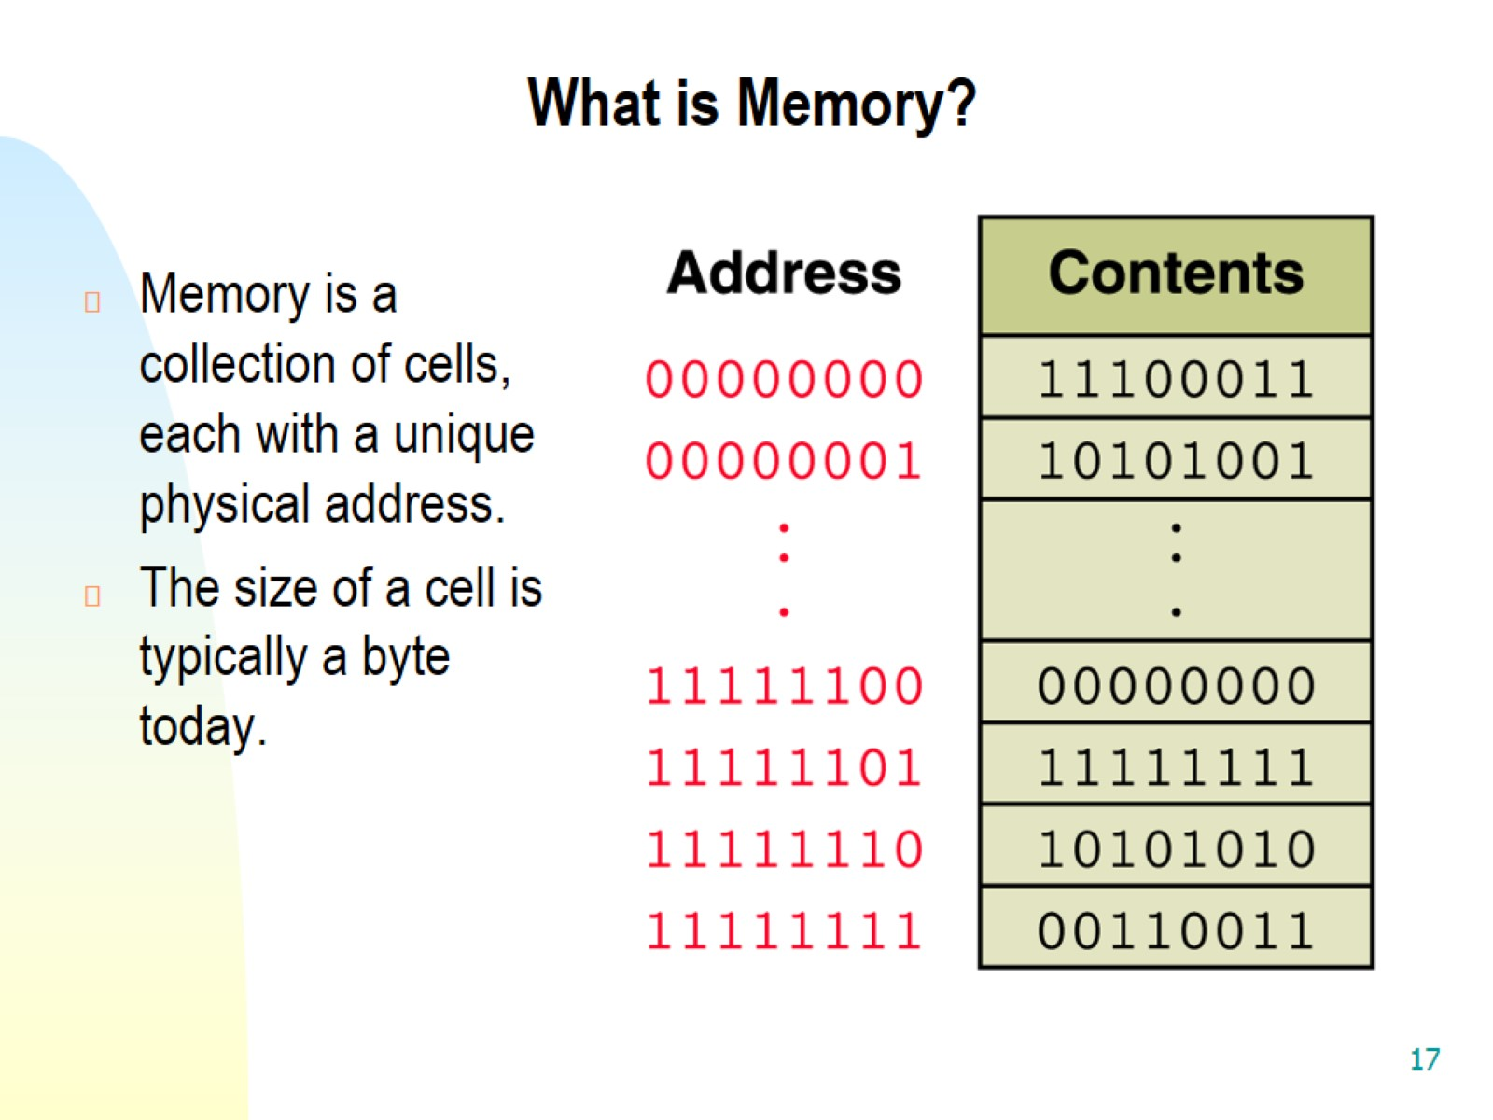
What is Memory?

Slide 18
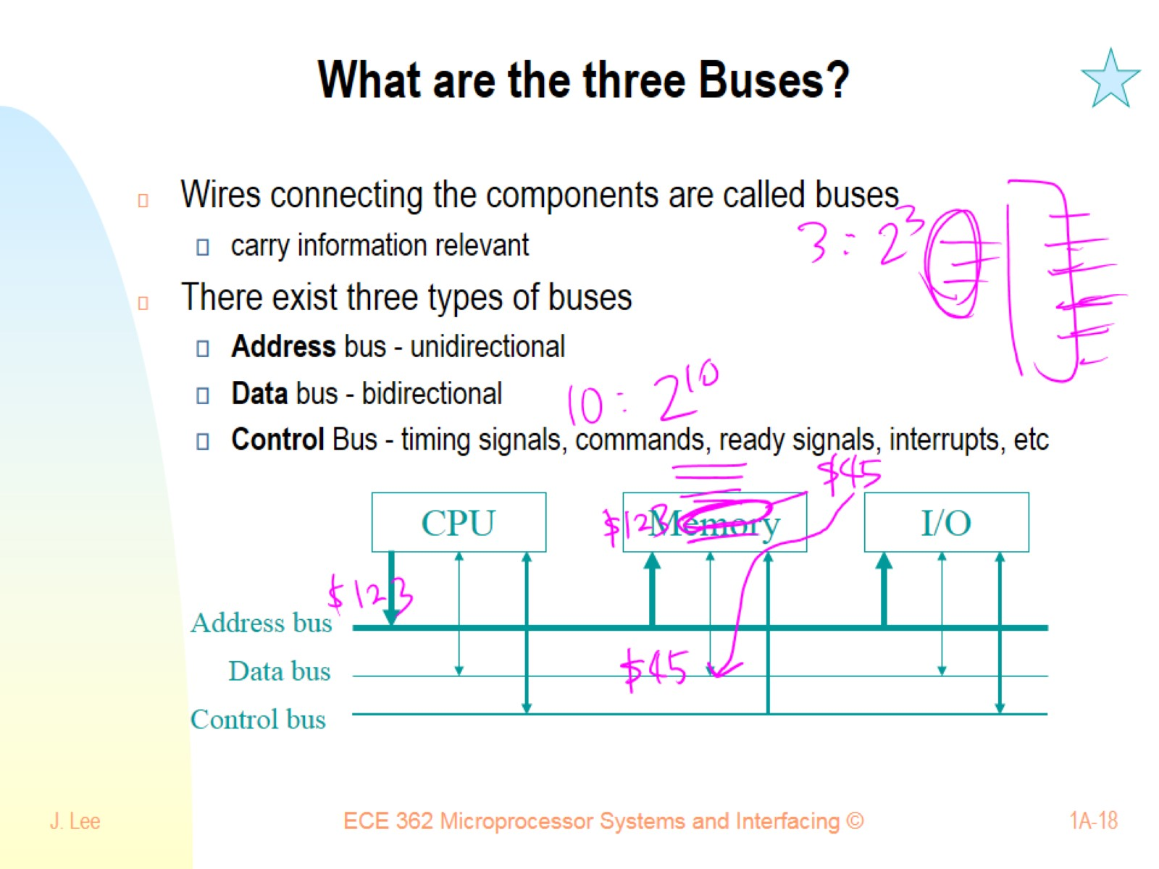
What are the three Buses?

Slide 19
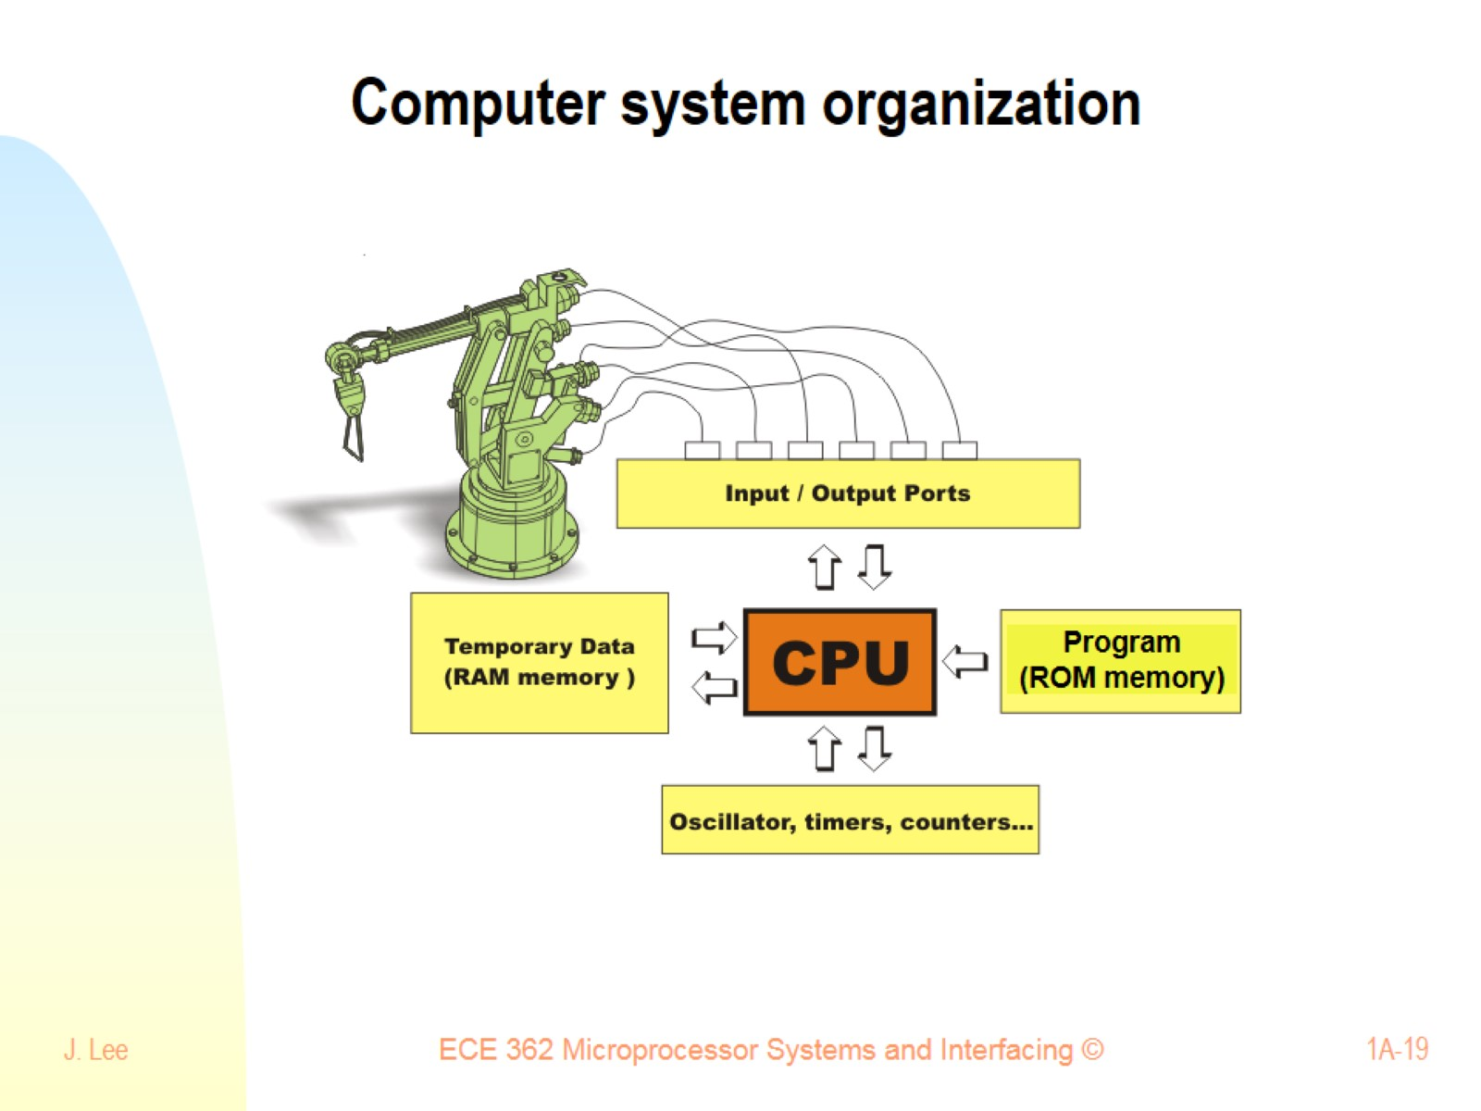
Computer system organization

Slide 20
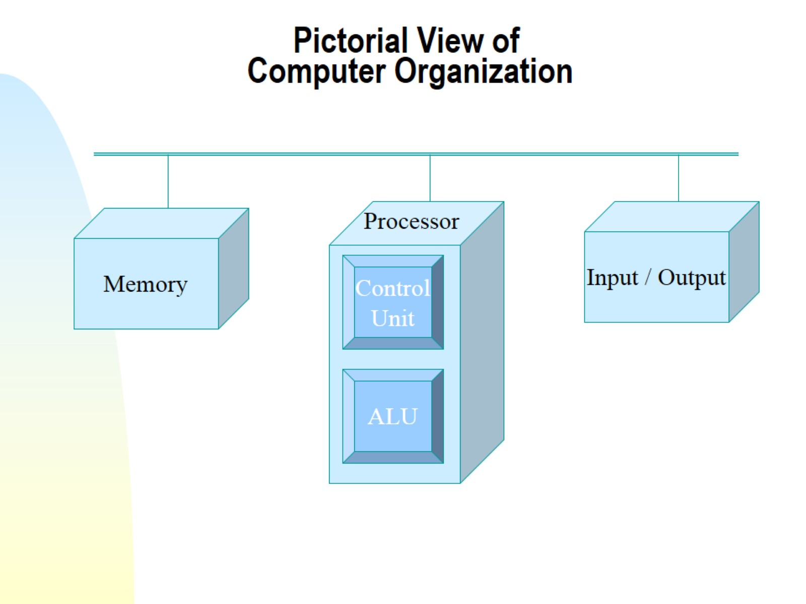
Pictorial View of Computer Organization

Slide 21
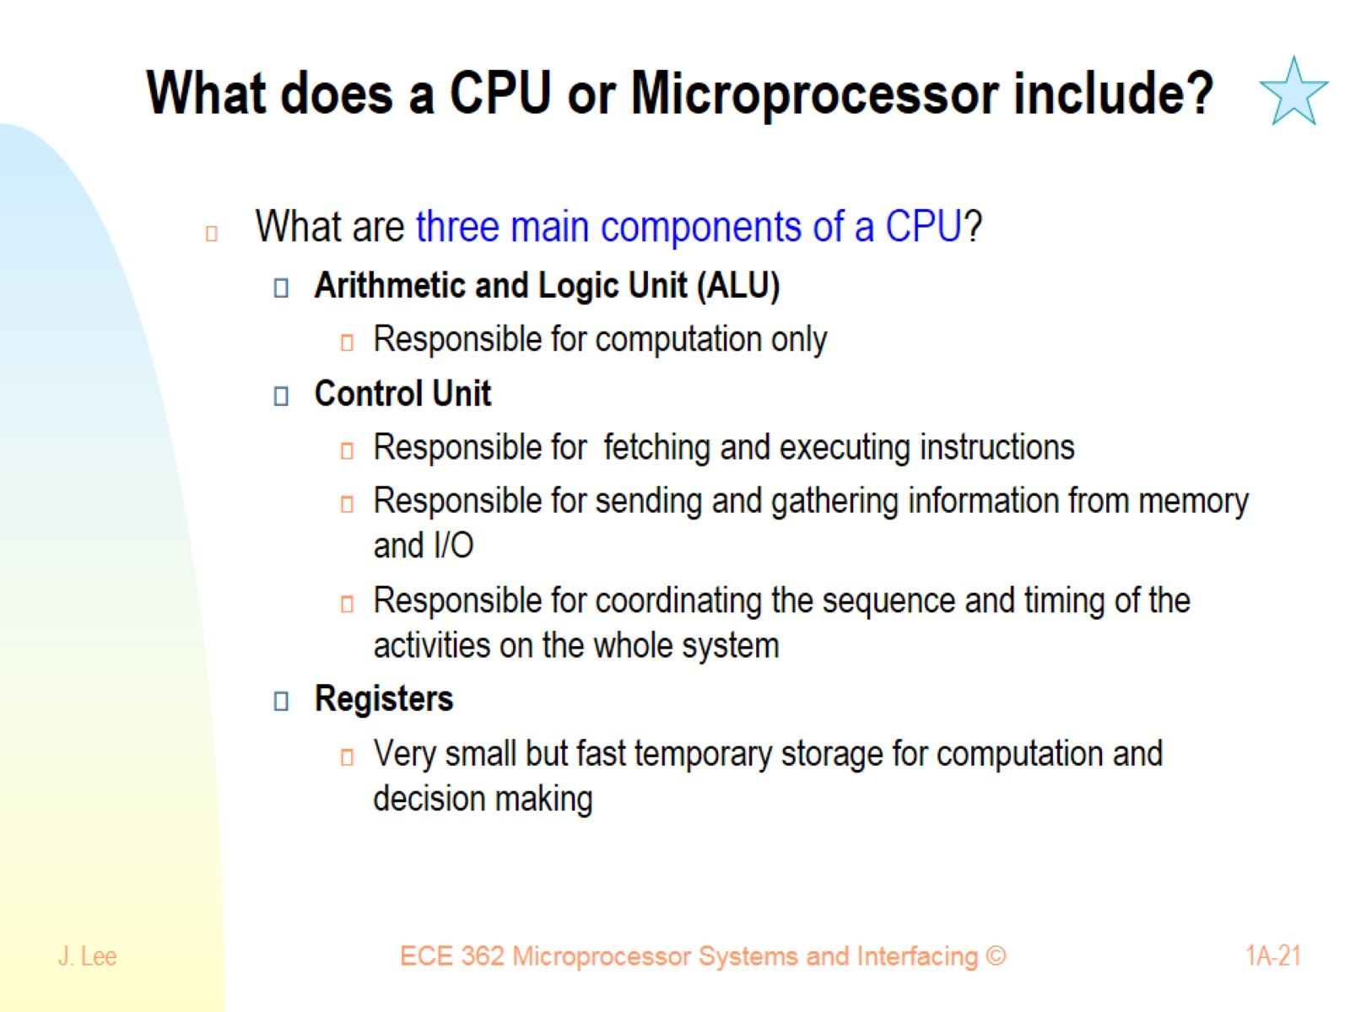
What does a CPU or Microprocessor include?

Slide 22
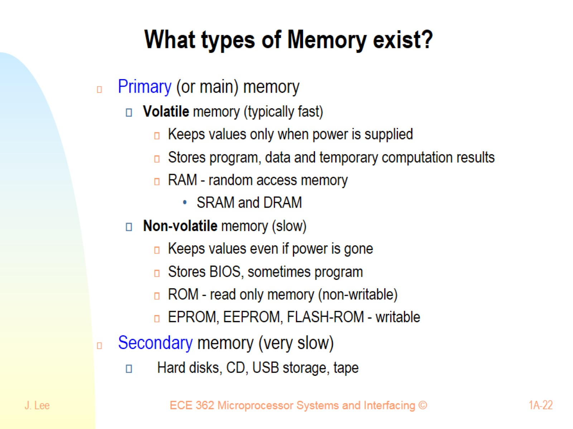
What types of Memory exist?

Slide 23
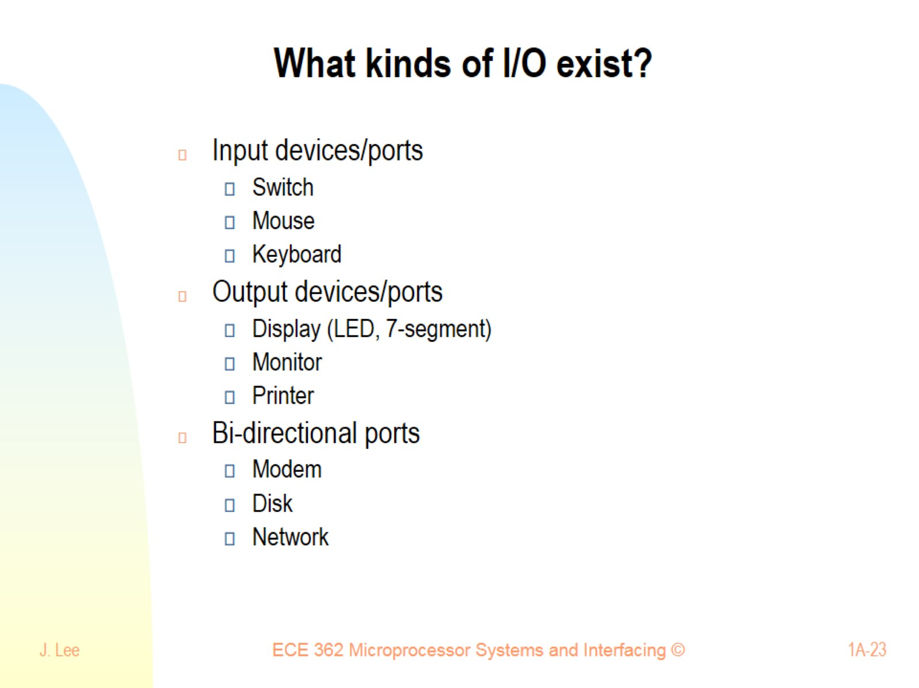
What kinds of I/O exist?

Slide 24
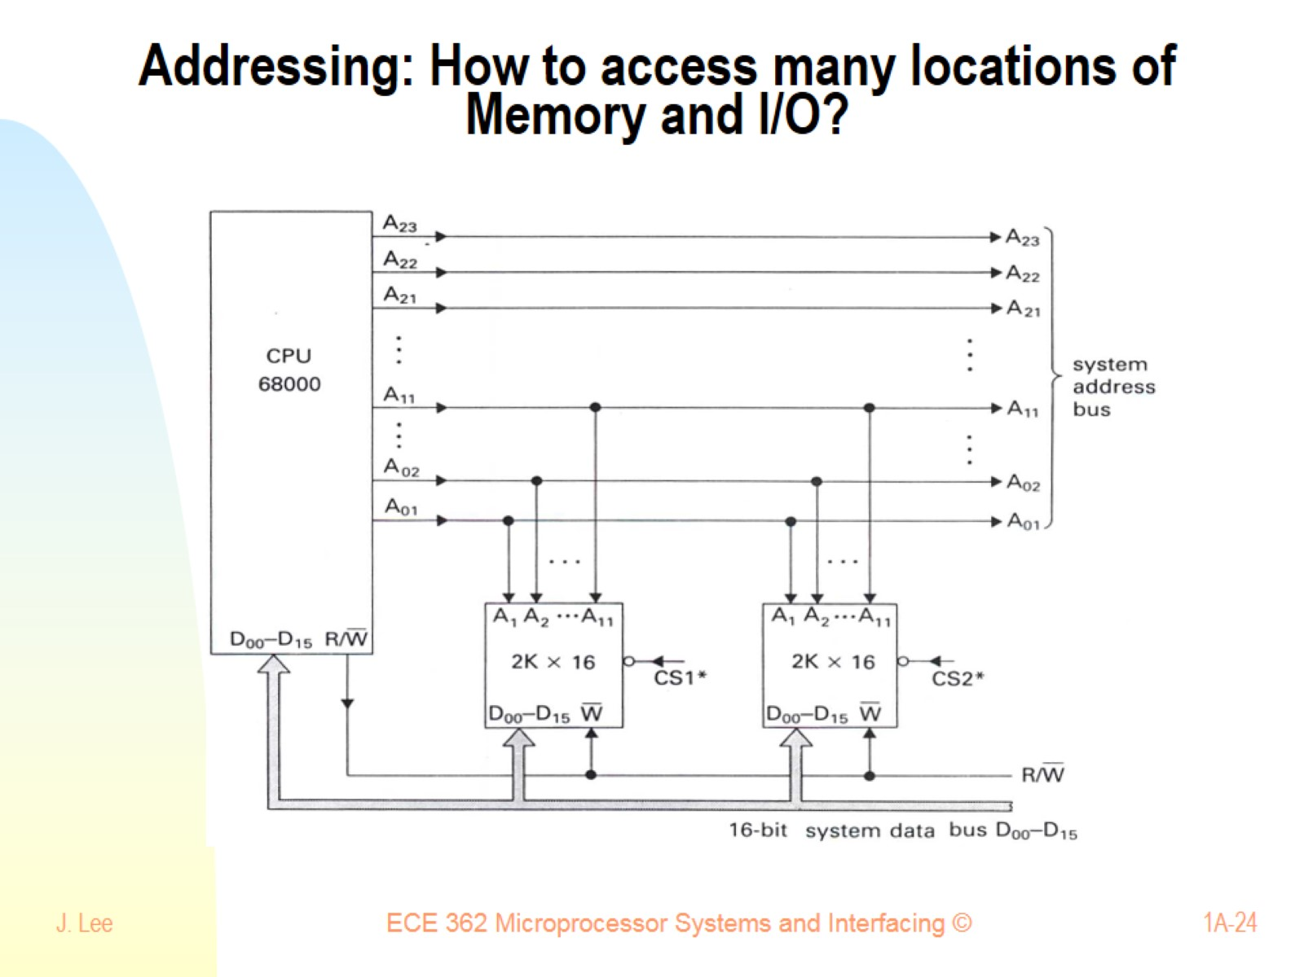
Addressing: How to access many locations of Memory and I/O?

Slide 25
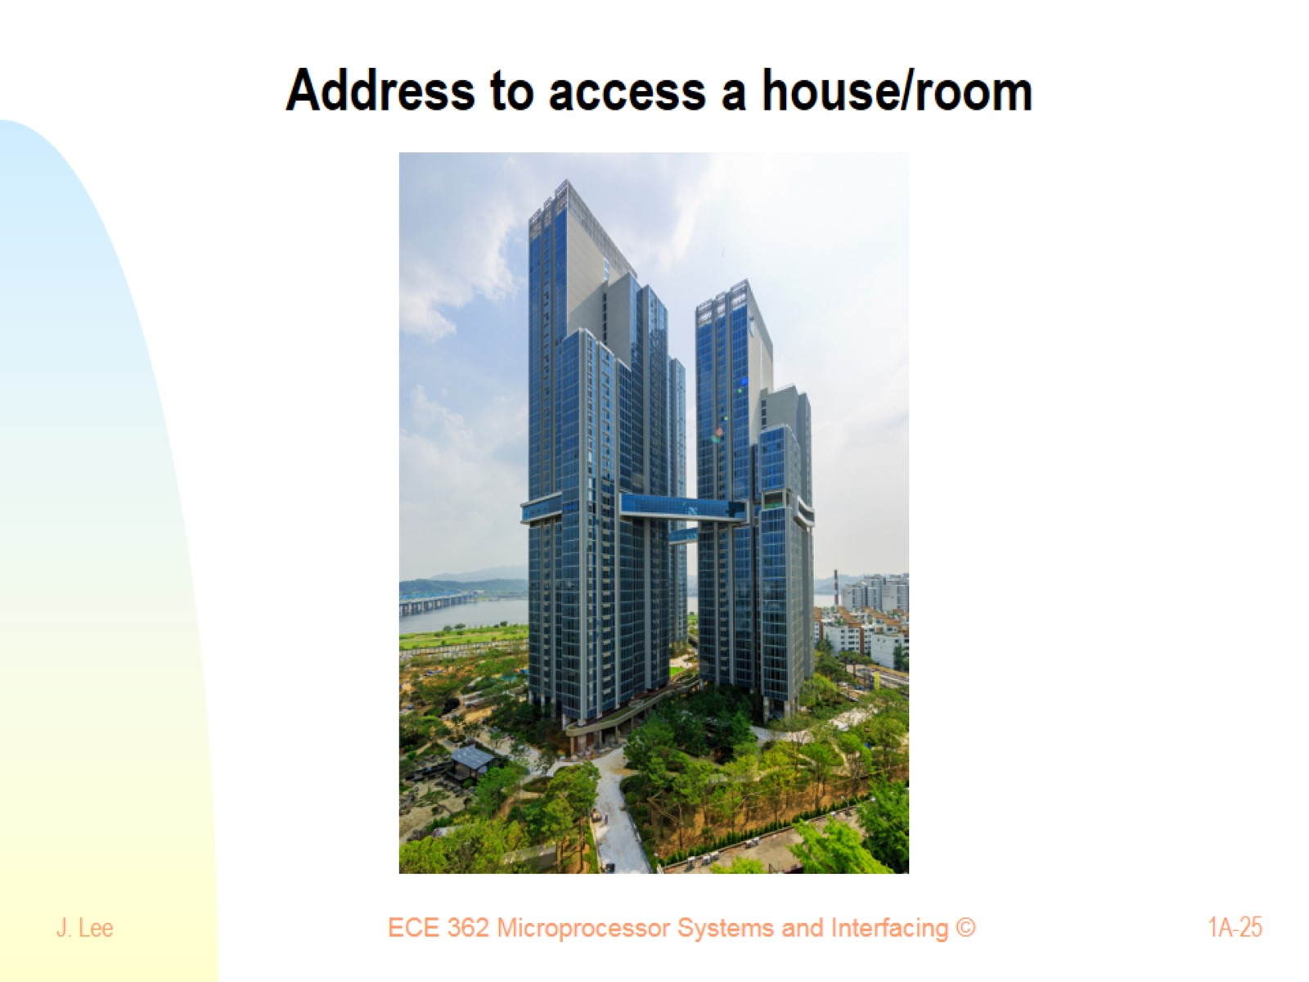
Address to access a house/room

Slide 26
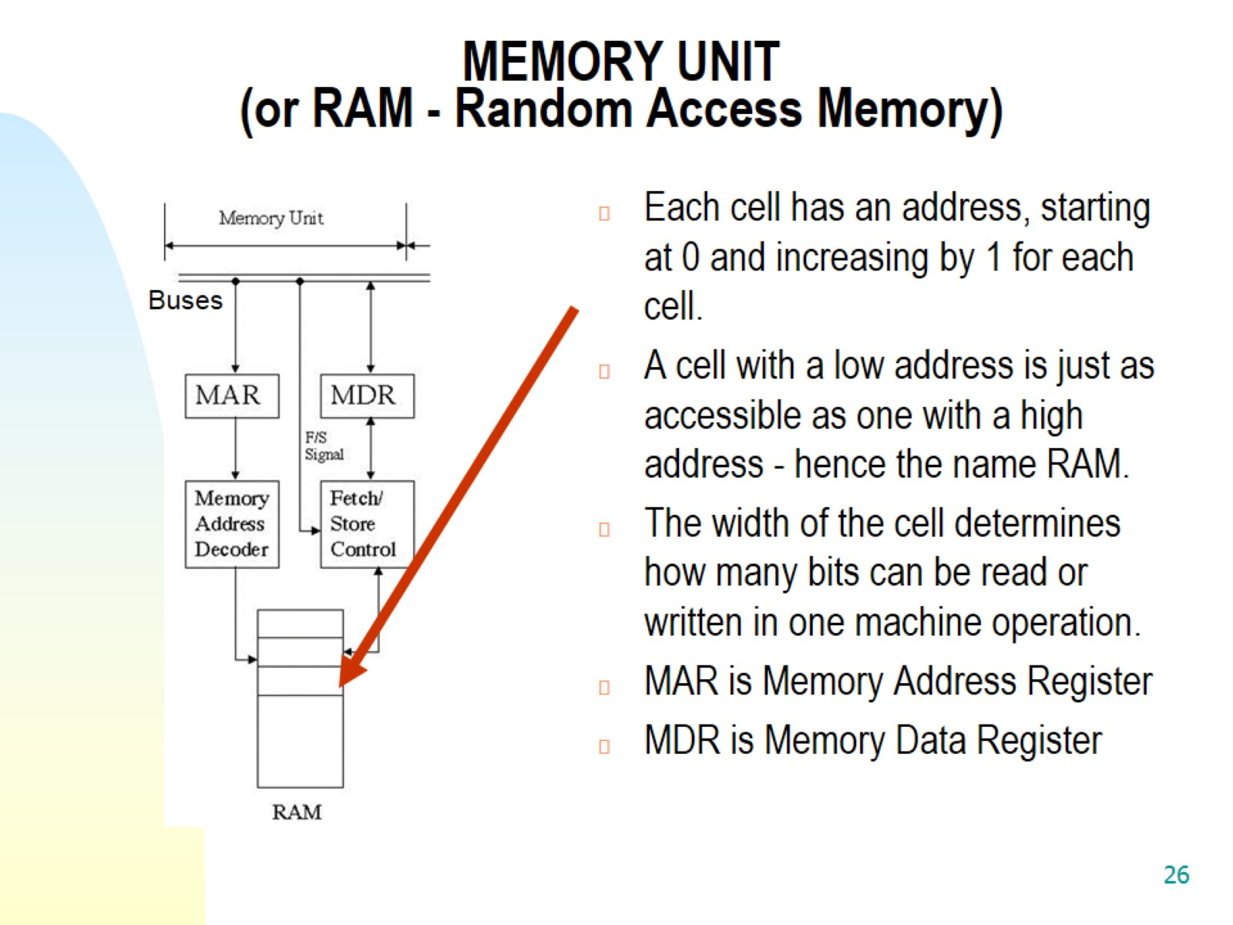
MEMORY UNIT (or RAM - Random Access Memory)

Slide 27
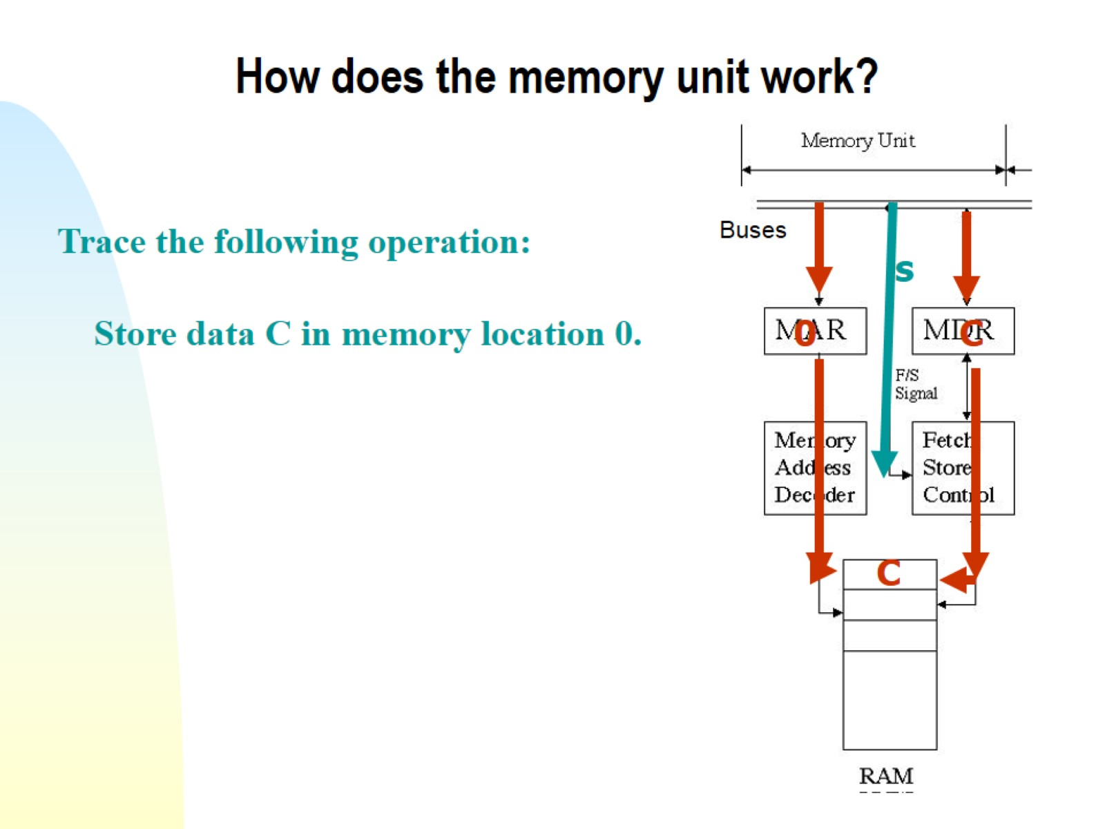
How does the memory unit work?

Slide 28
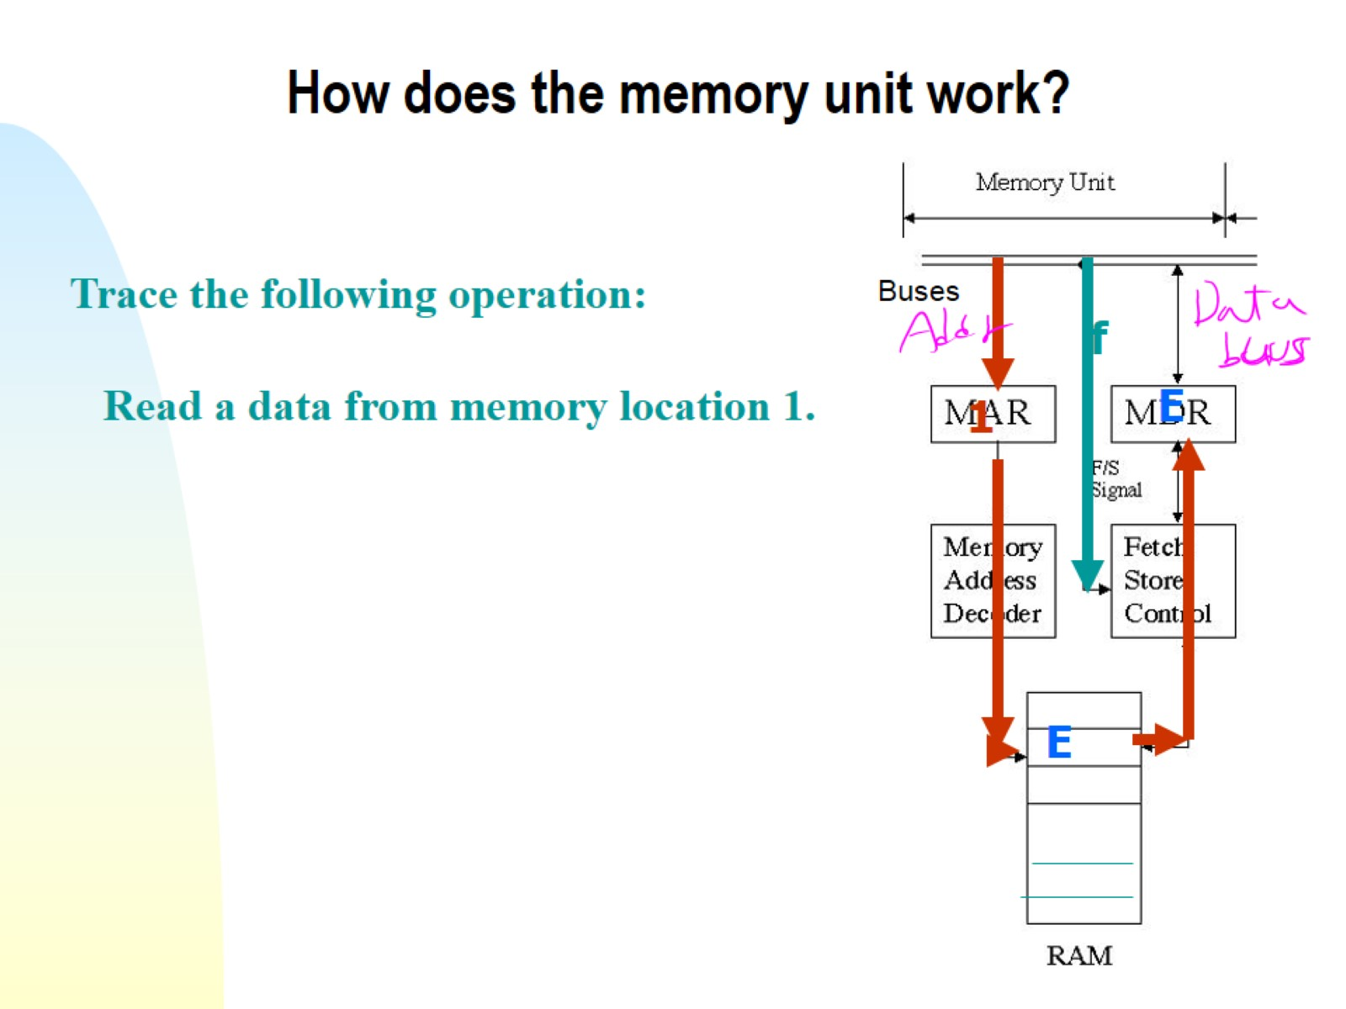
How does the memory unit work?

Slide 29
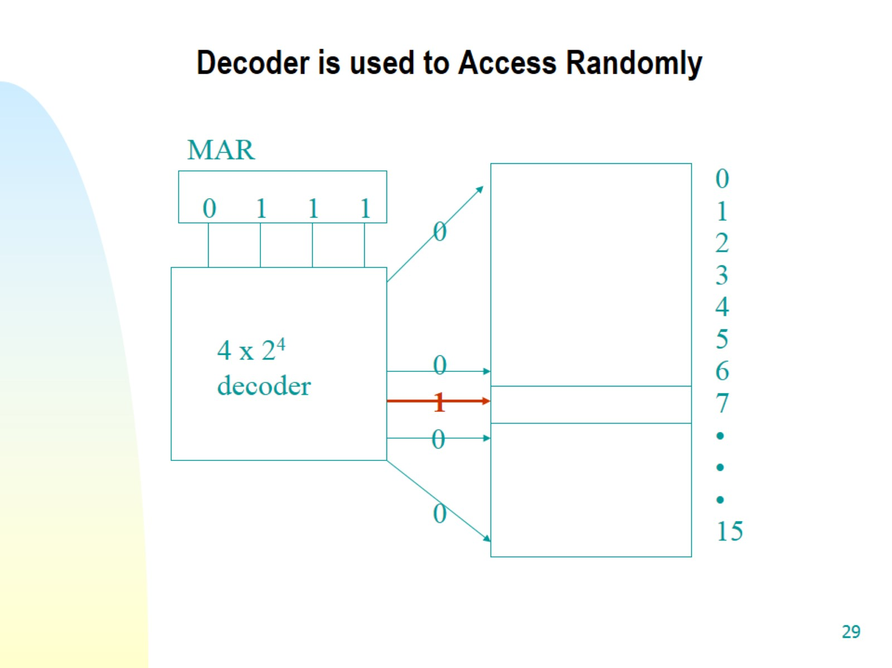
Decoder is used to Access Randomly

Slide 30
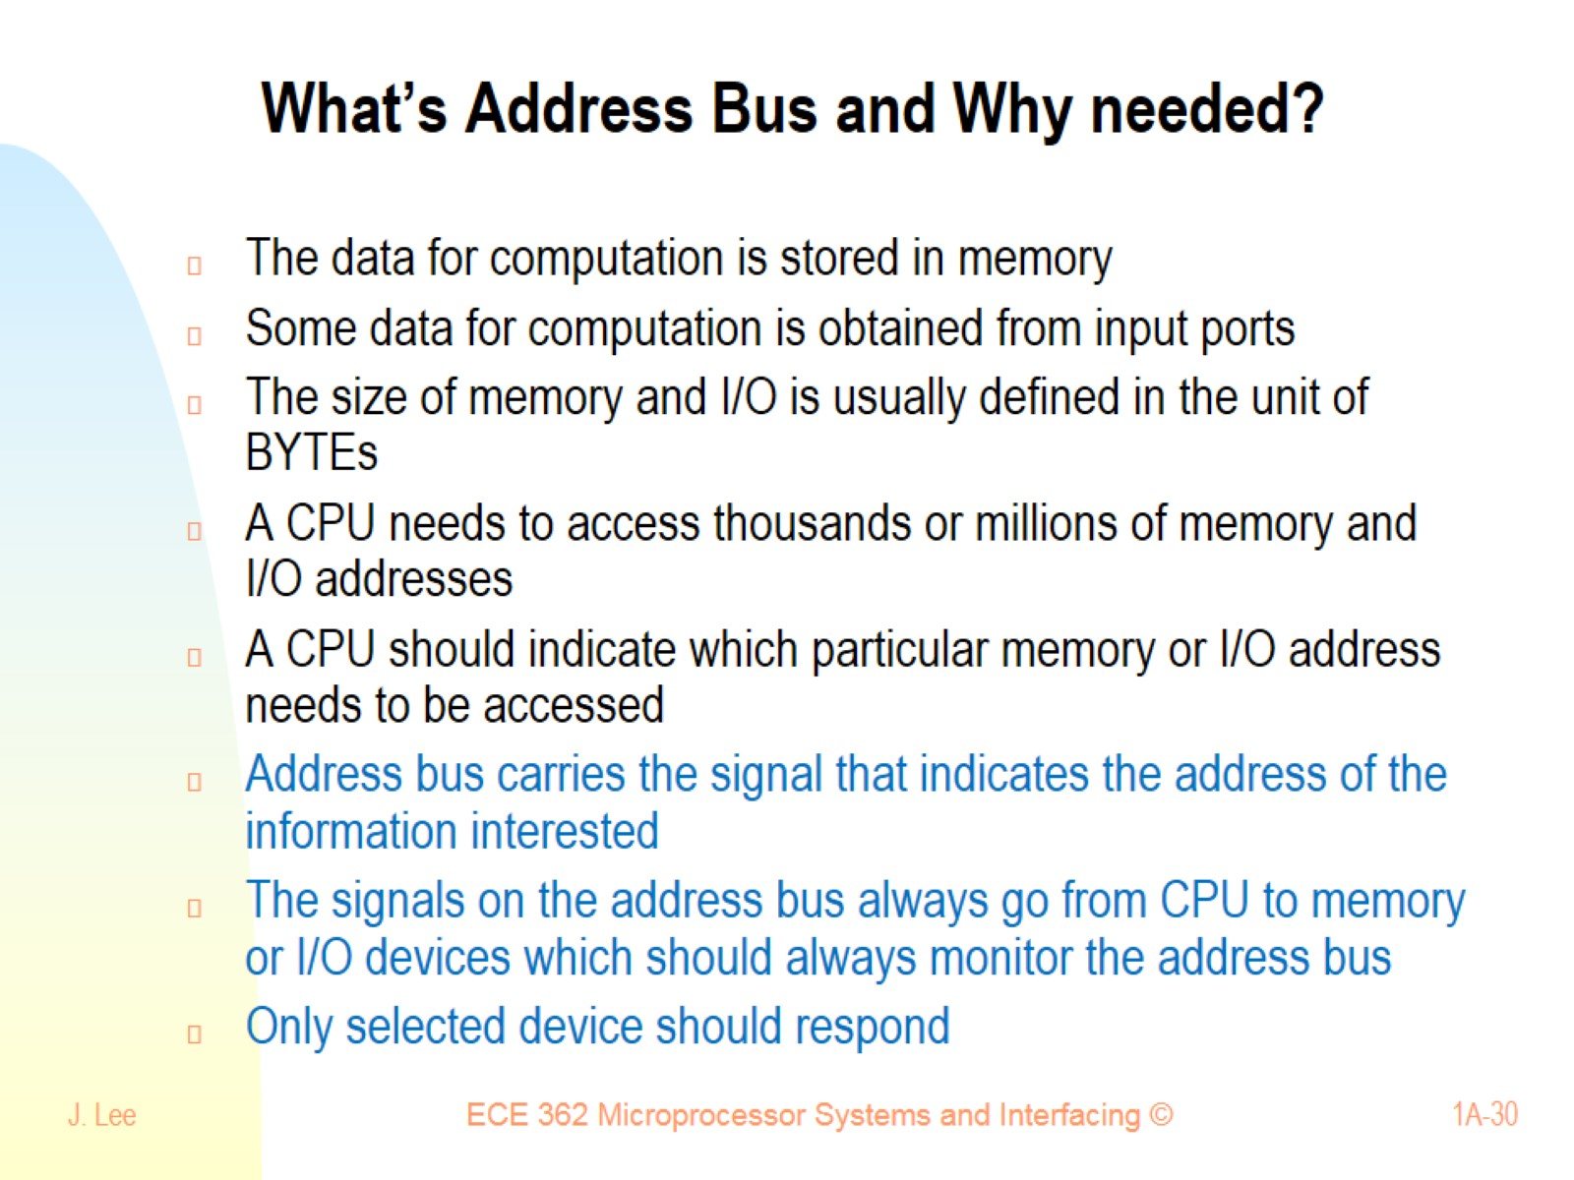
What’s Address Bus and Why needed?

Slide 31
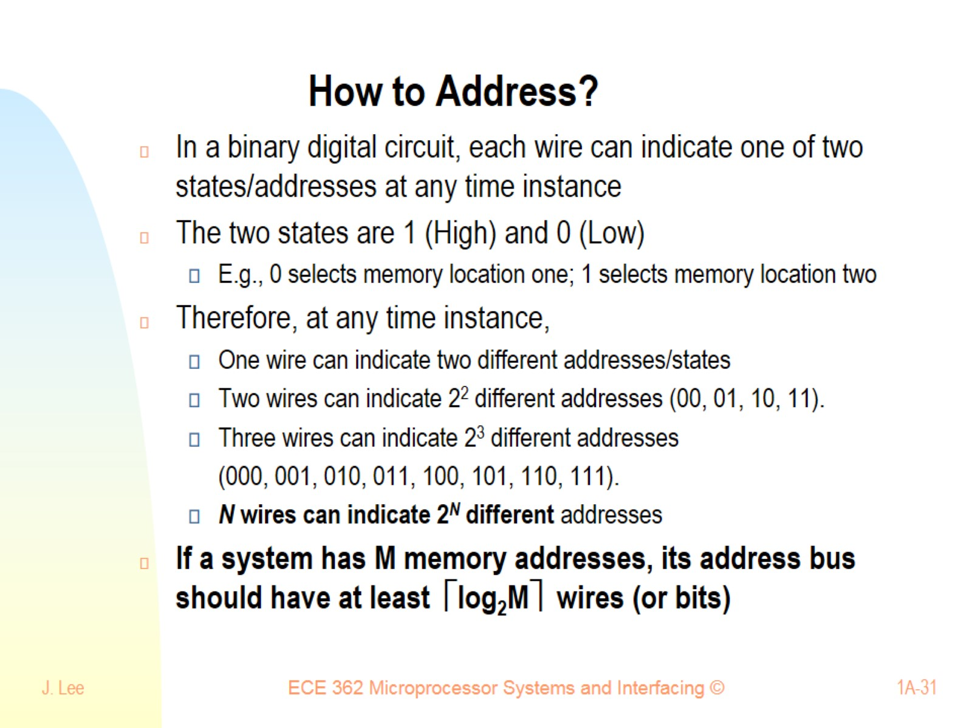
How to Address?

Slide 32
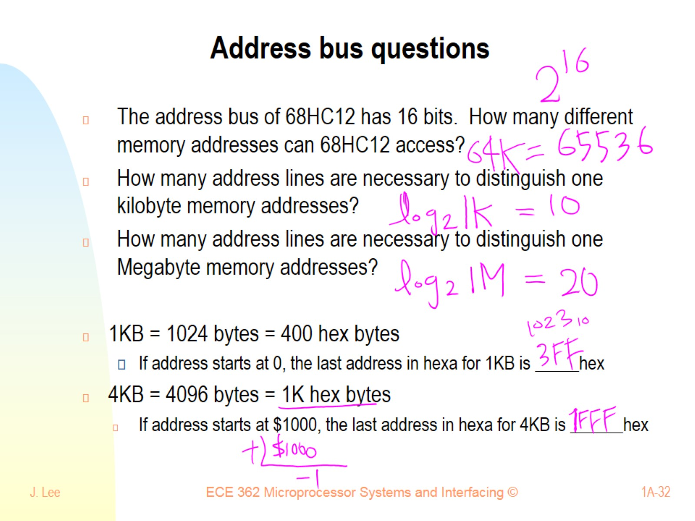
Address bus questions

Slide 33
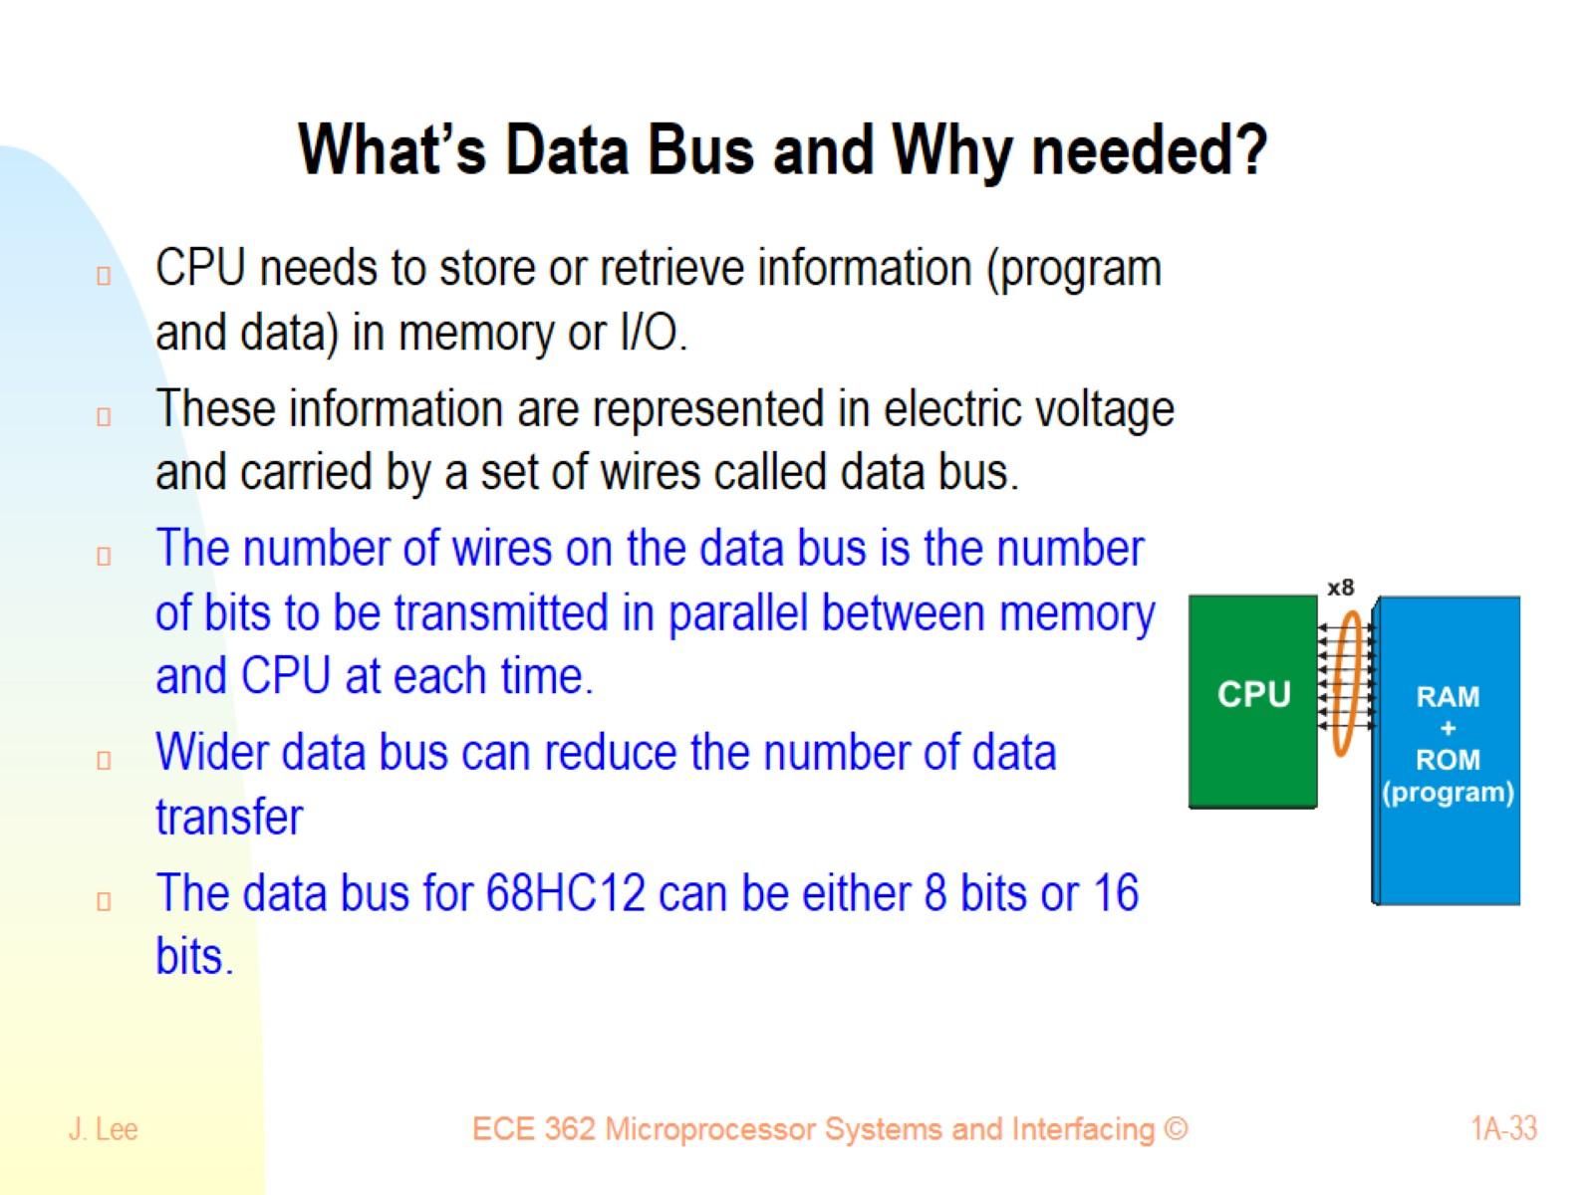
What’s Data Bus and Why needed?

Slide 34
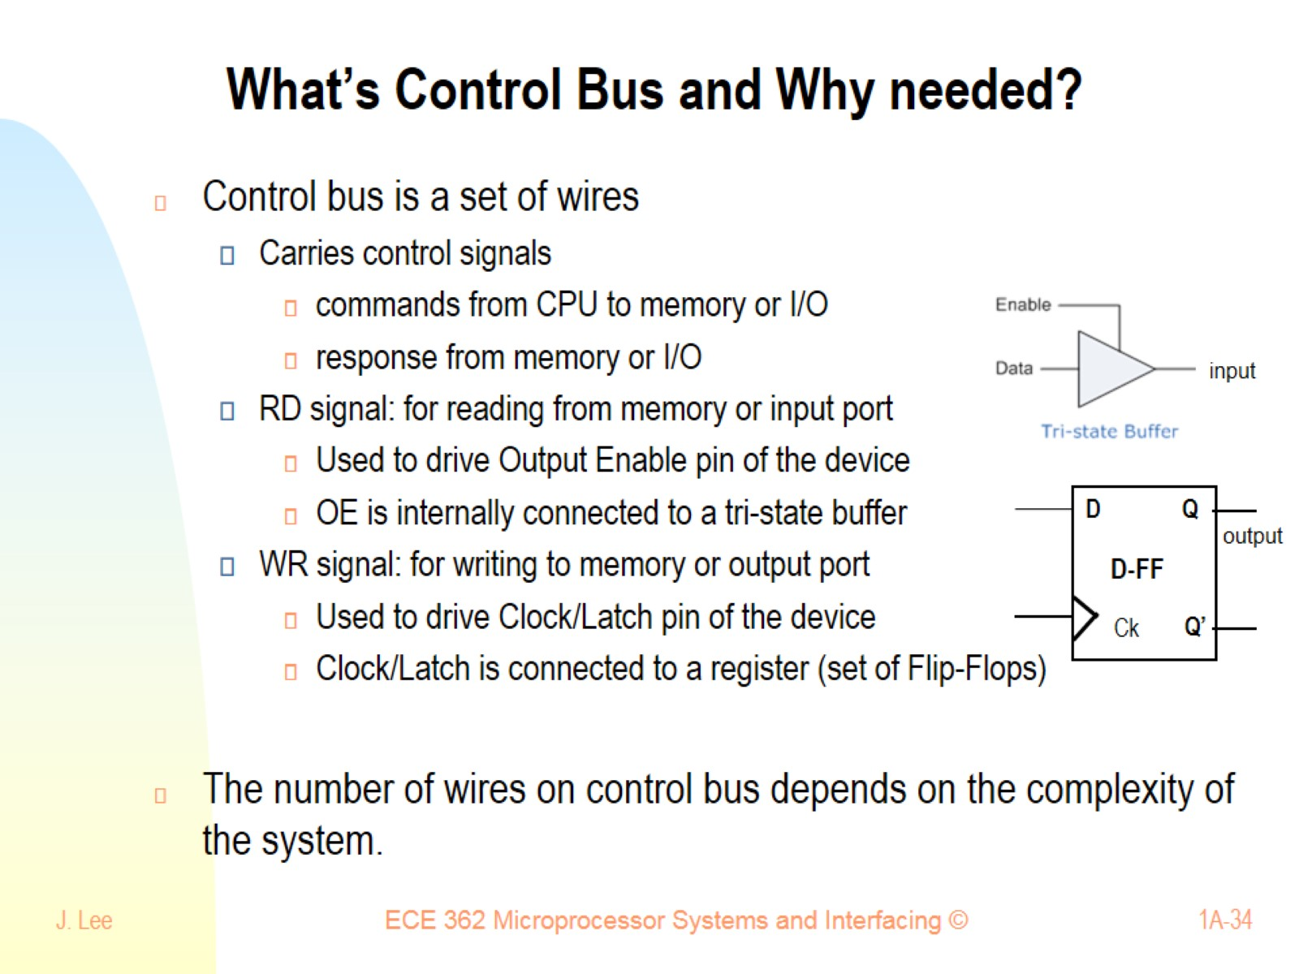
What’s Control Bus and Why needed?

Slide 35
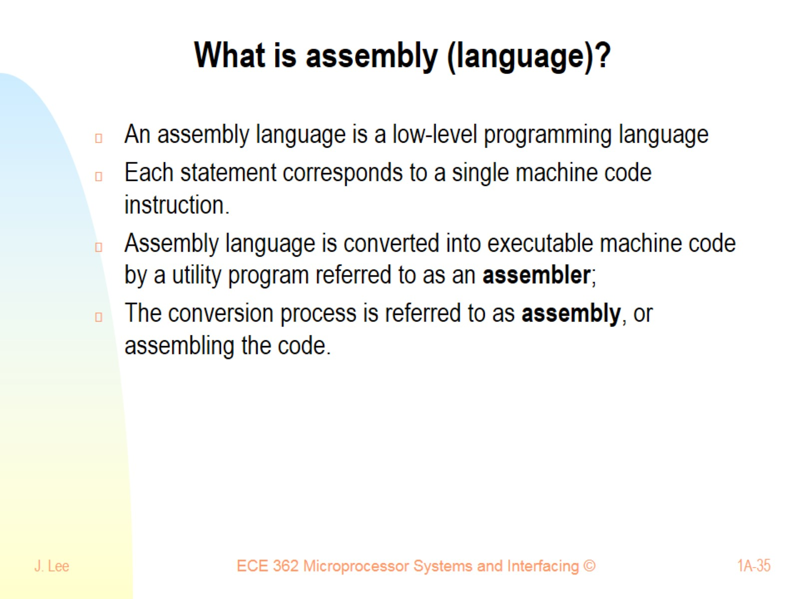
What is assembly (language)?

Slide 36
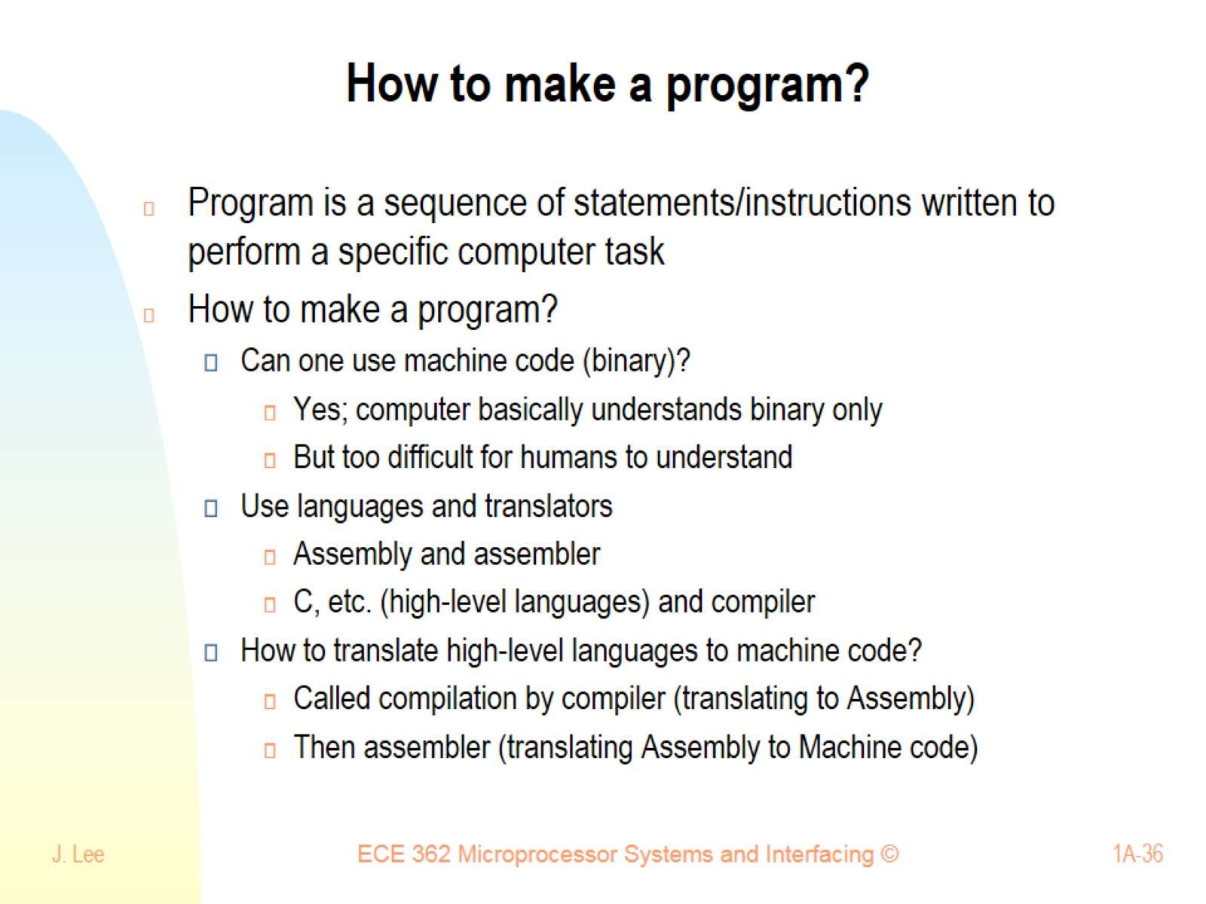
How to make a program?

Slide 37
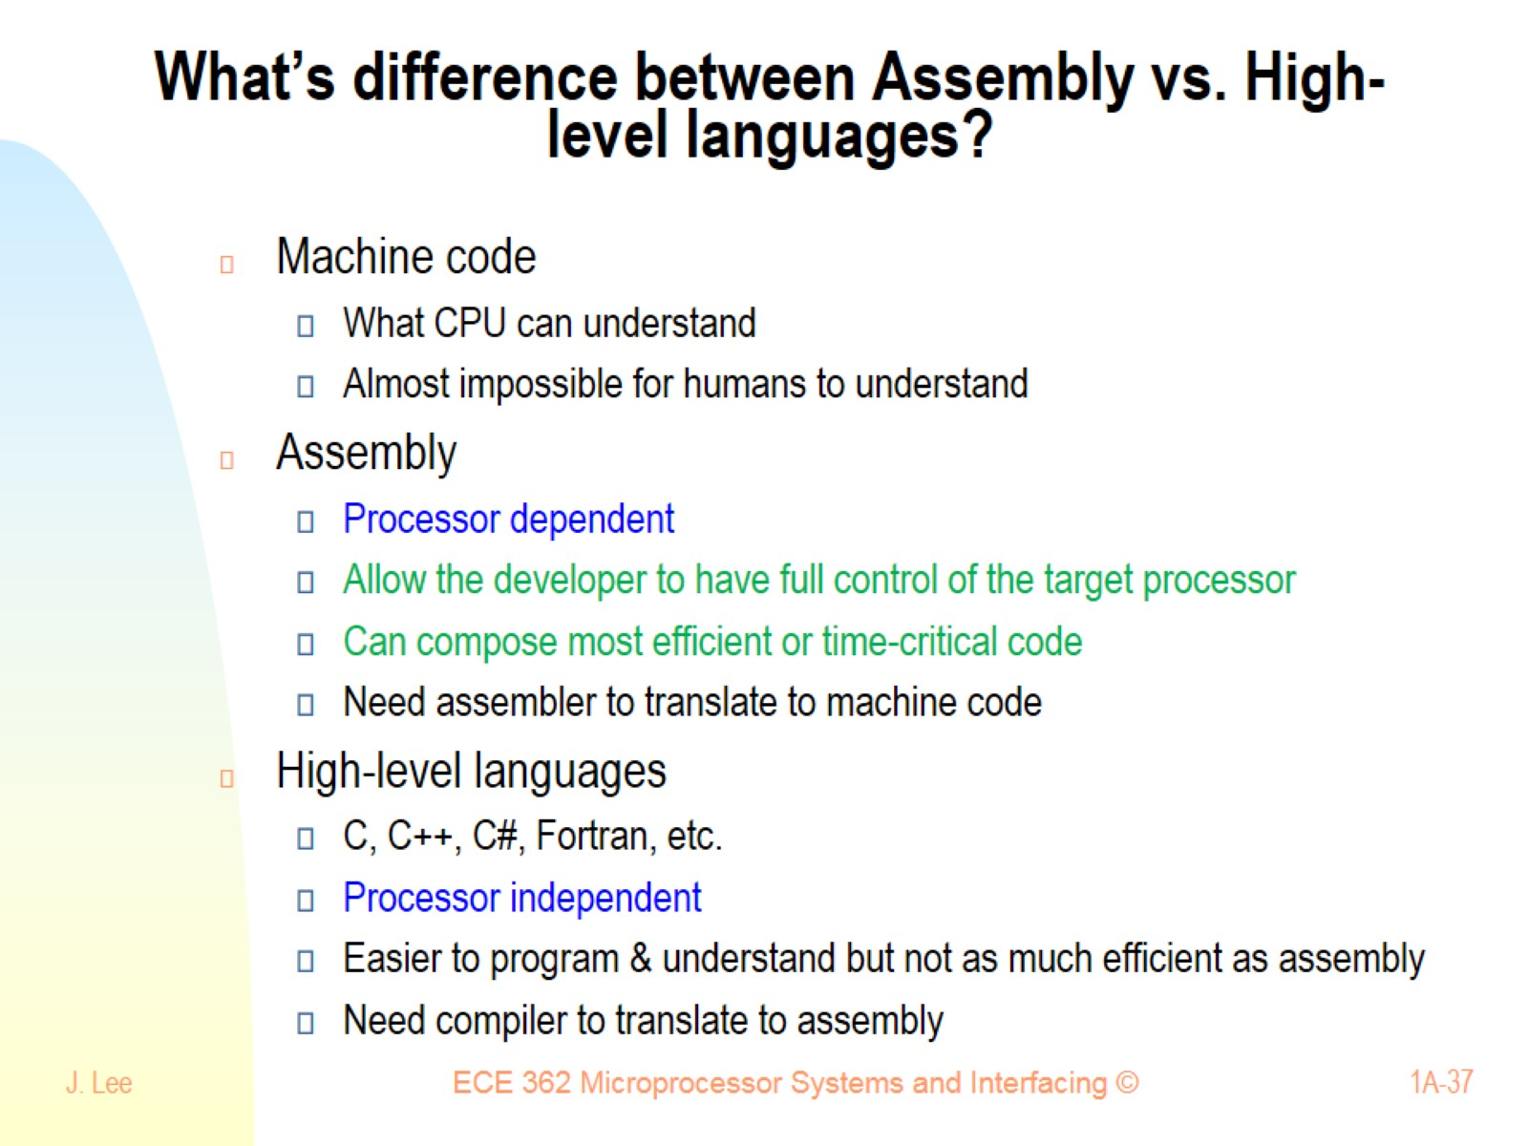
What’s difference between Assembly vs. High-level languages?

Slide 38
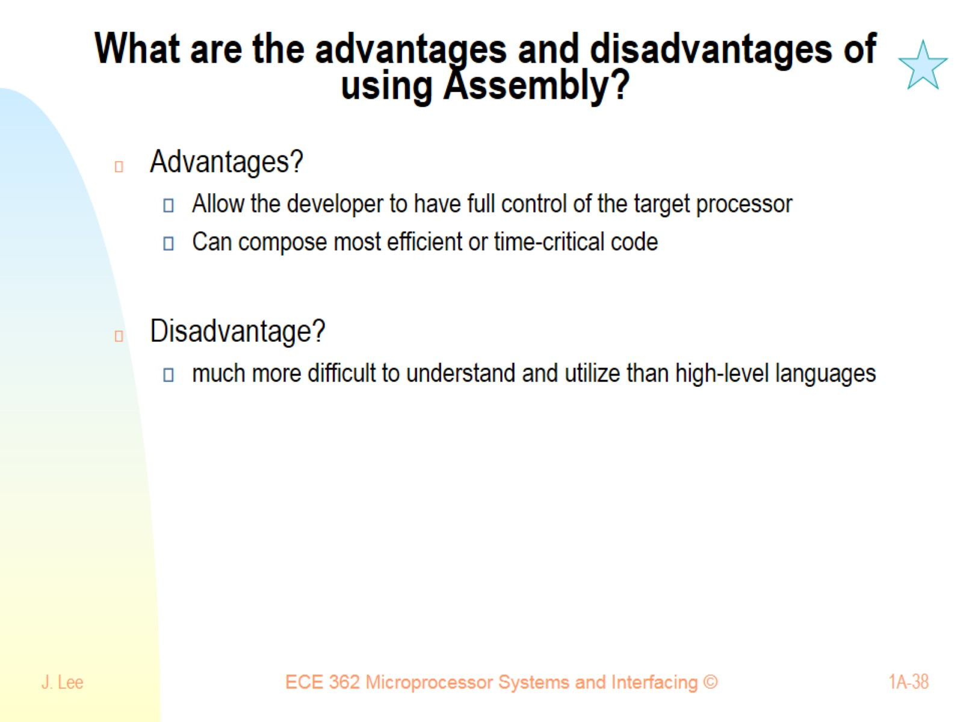
What are the advantages and disadvantages of using Assembly?

Slide 39
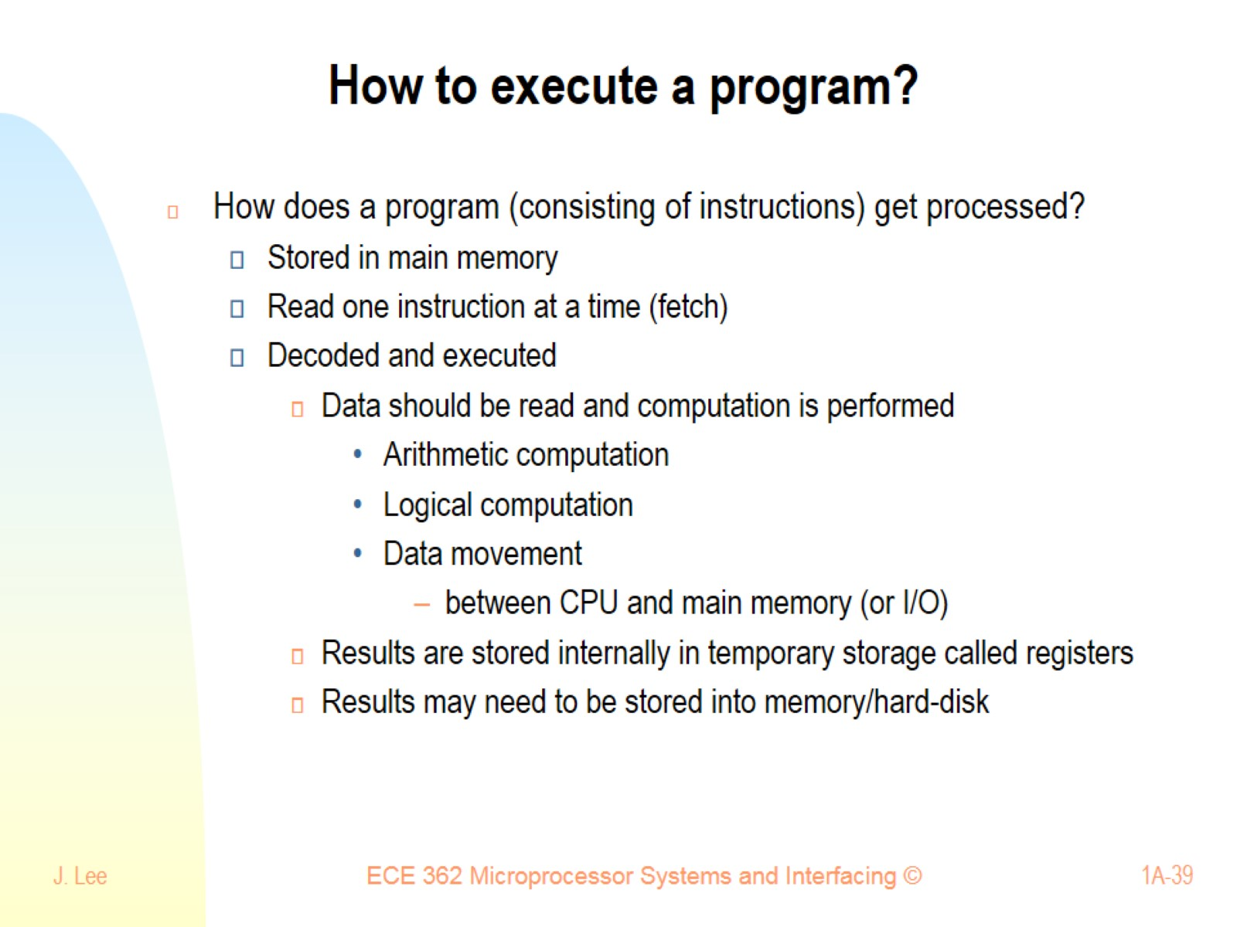
How to execute a program?

Slide 40
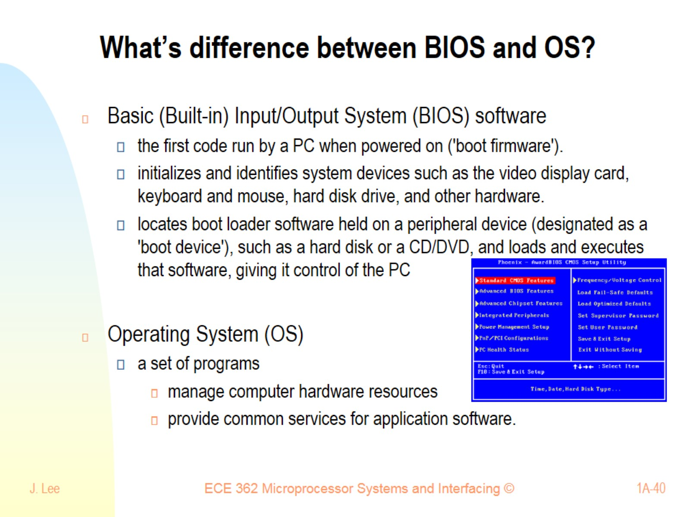
What’s difference between BIOS and OS?

Slide 41
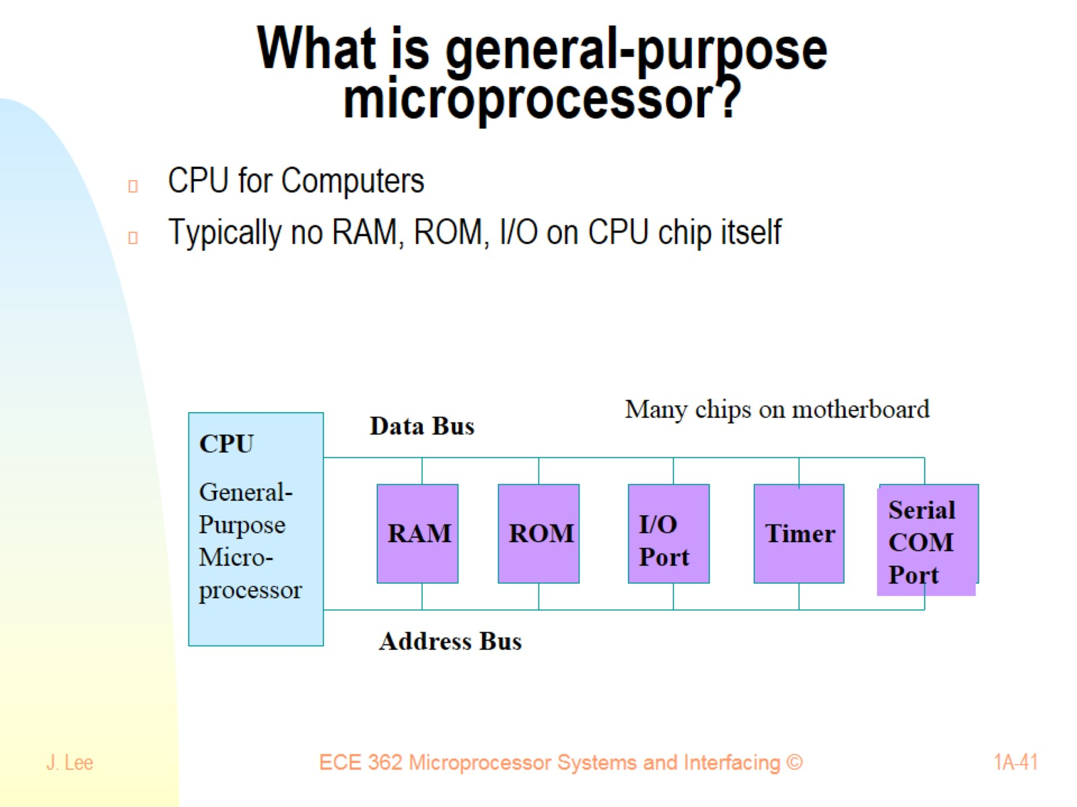
What is general-purpose microprocessor?

Slide 42
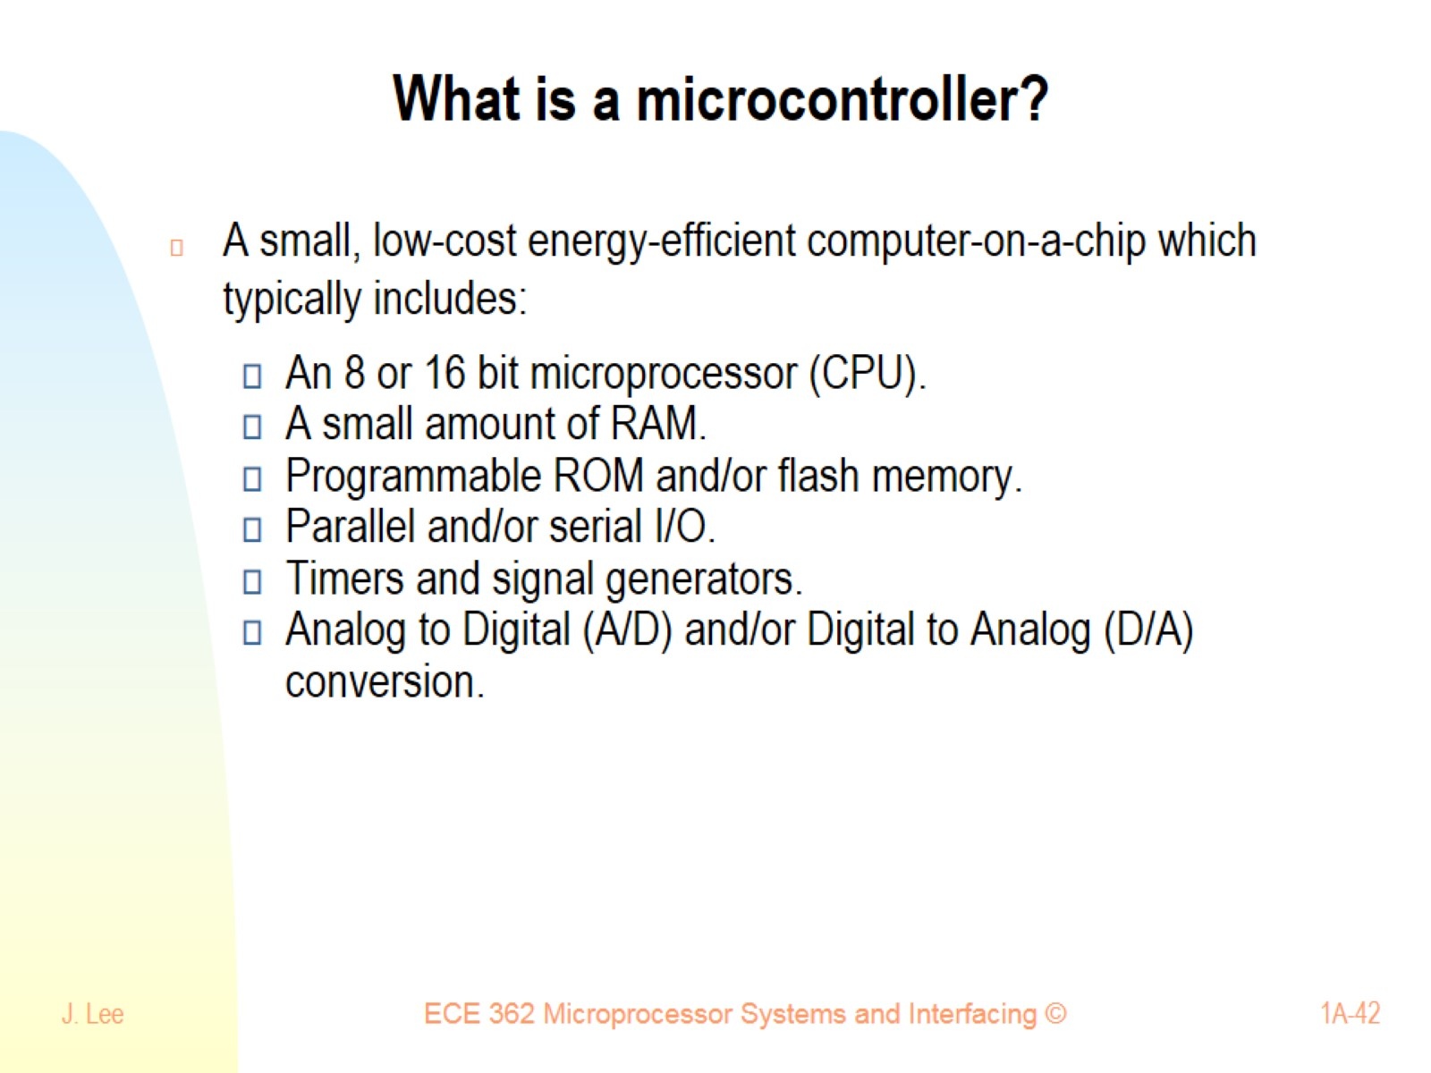
What is a microcontroller?

Slide 43
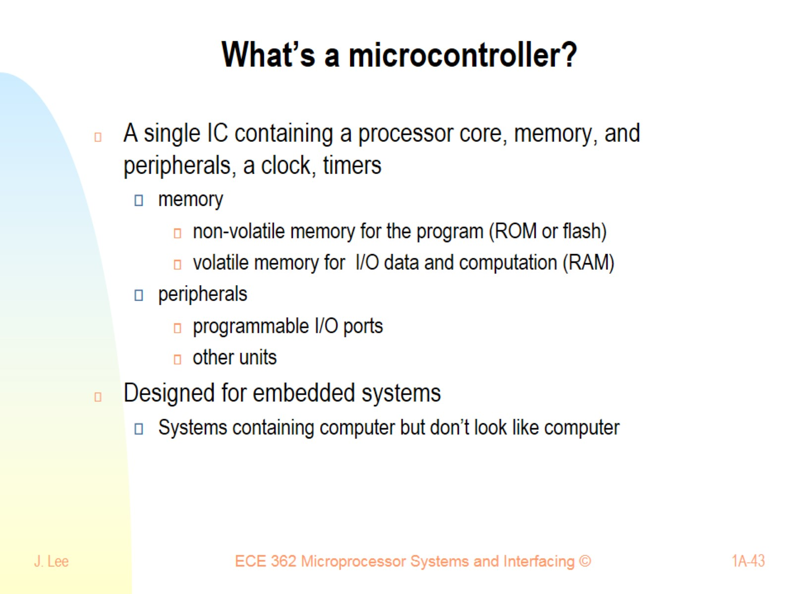
What’s a microcontroller?

Slide 44
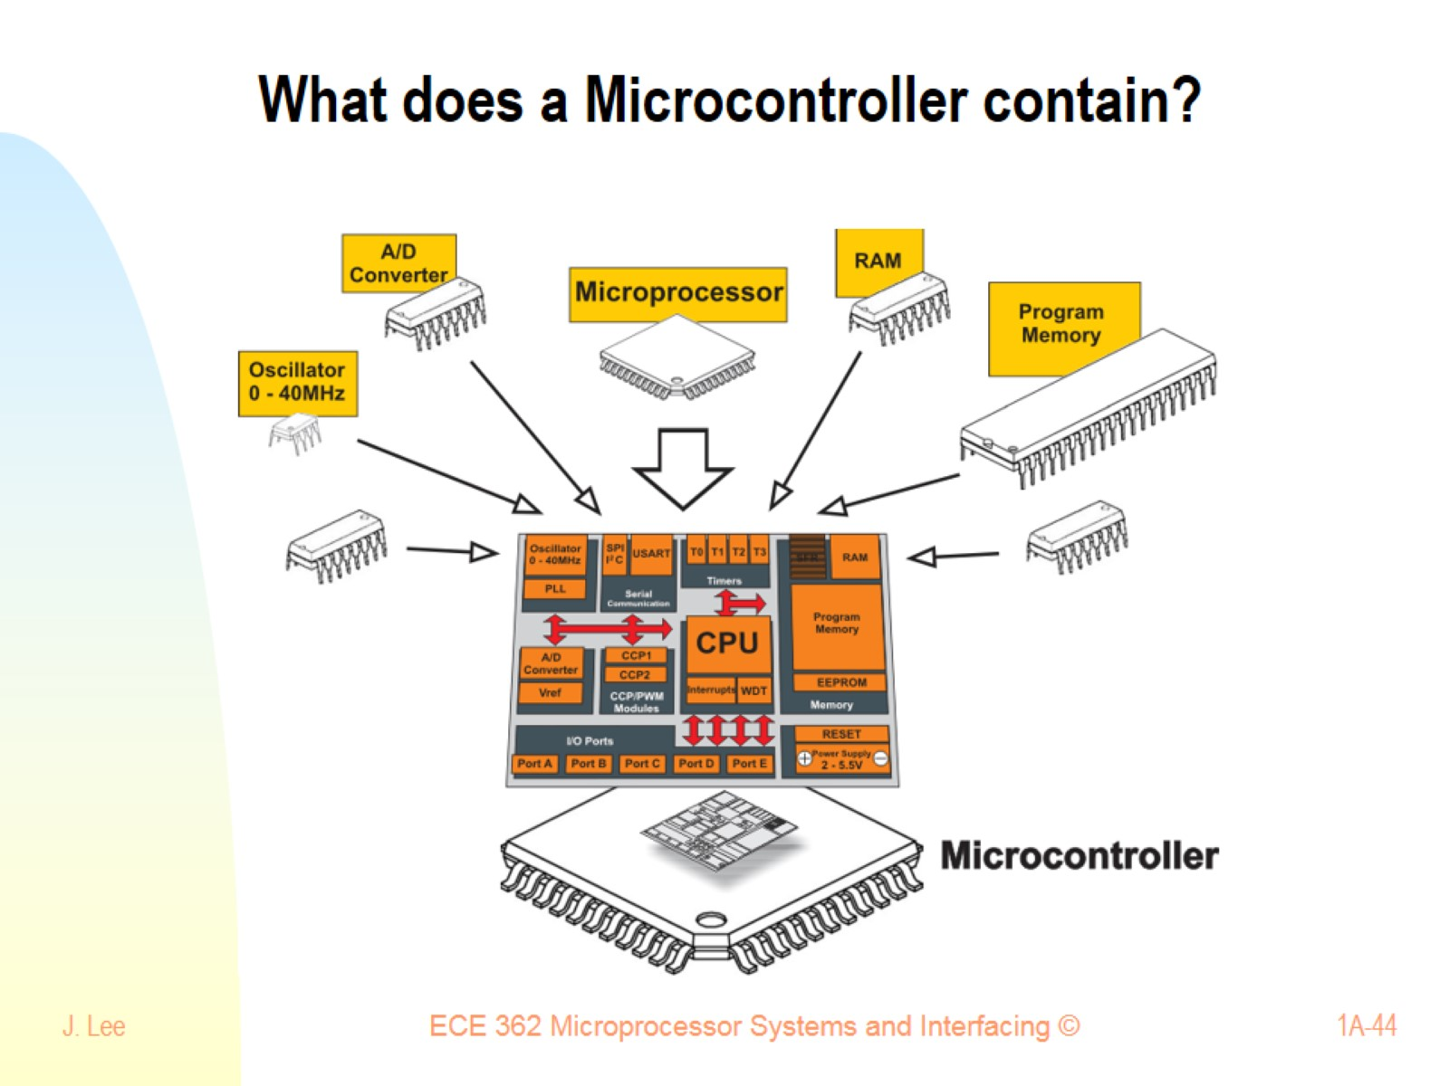
What does a Microcontroller contain?

Slide 45
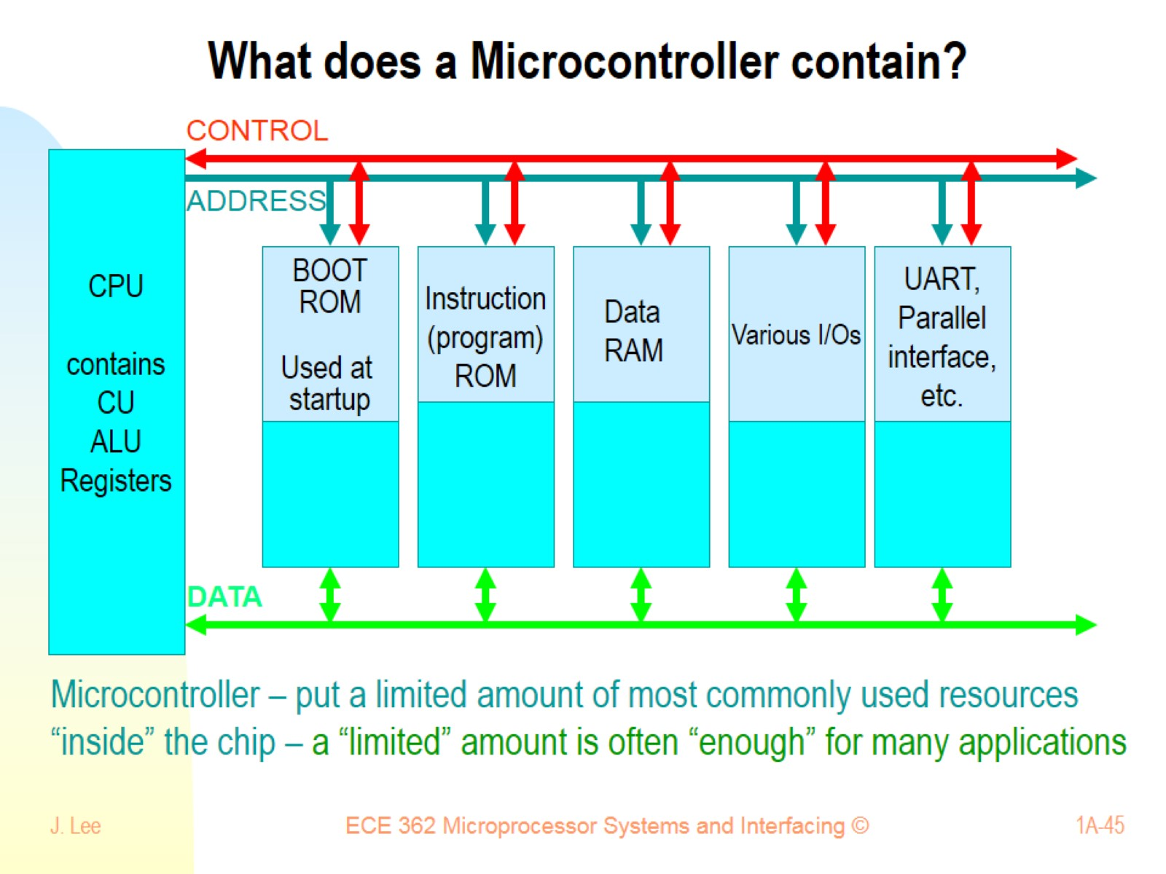
What does a Microcontroller contain?

Slide 46
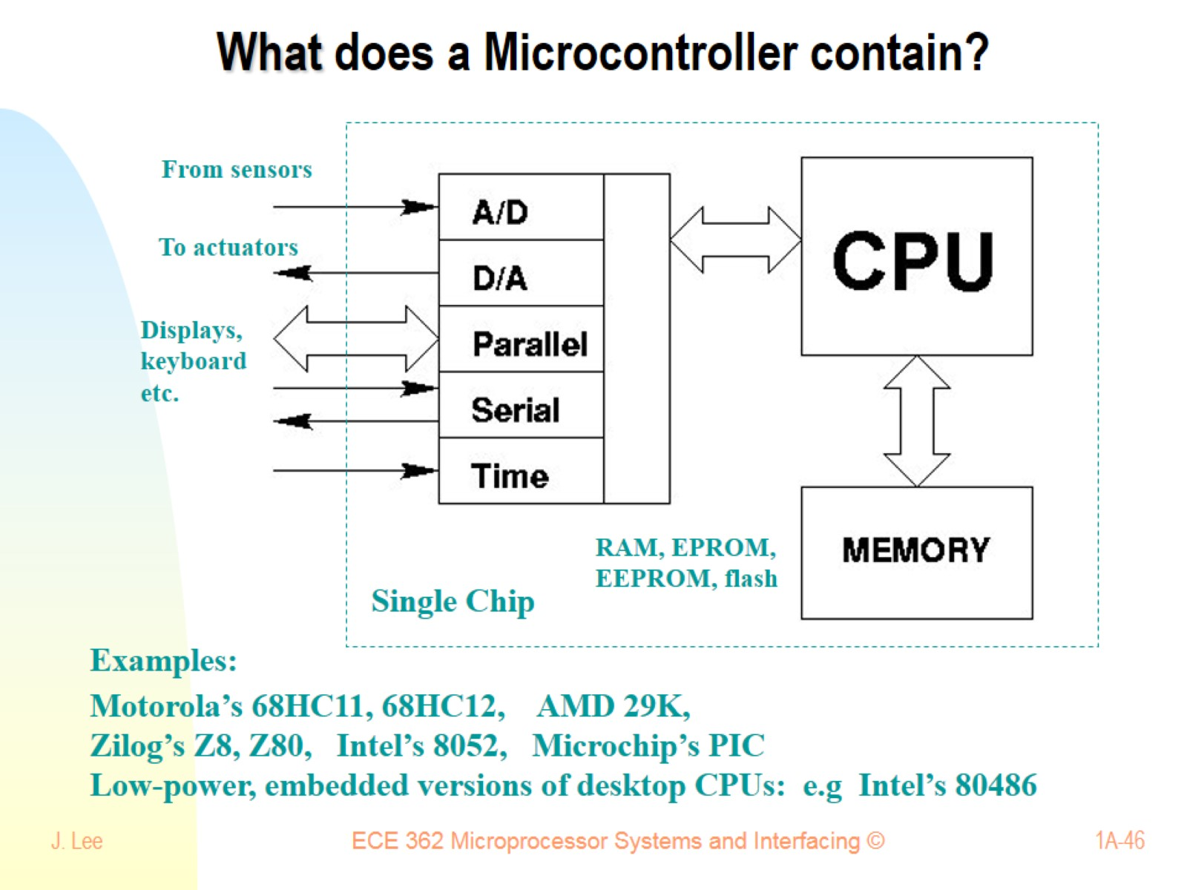
What does a Microcontroller contain?

Slide 47
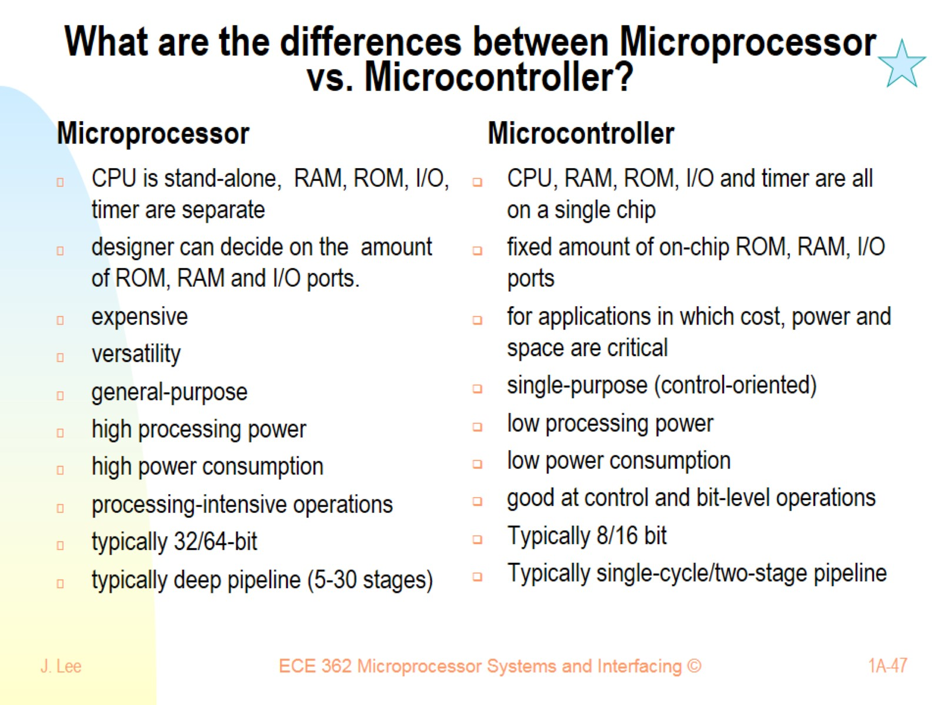
What are the differences between Microprocessor vs. Microcontroller?

Slide 48
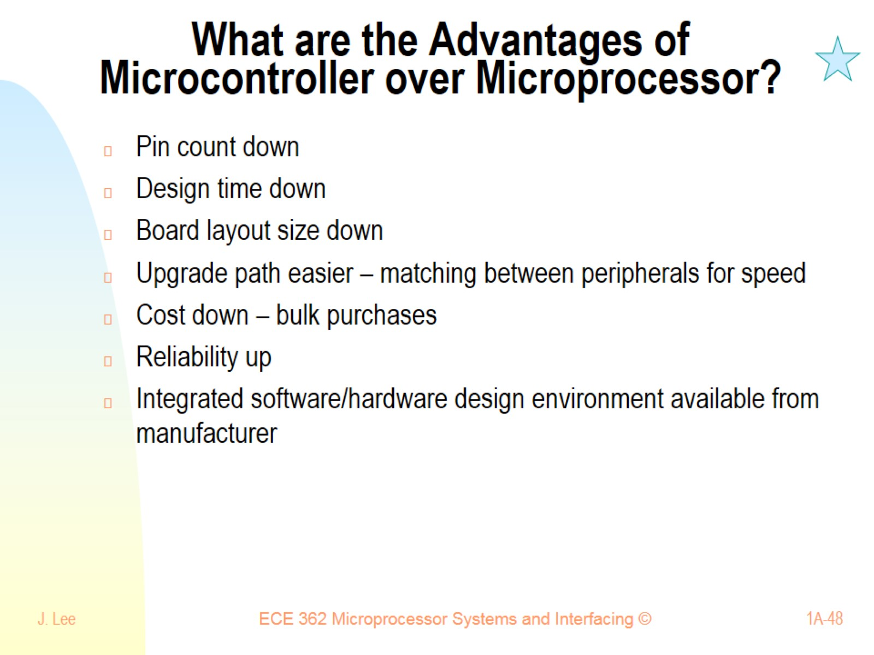
What are the Advantages of Microcontroller over Microprocessor?

Slide 49
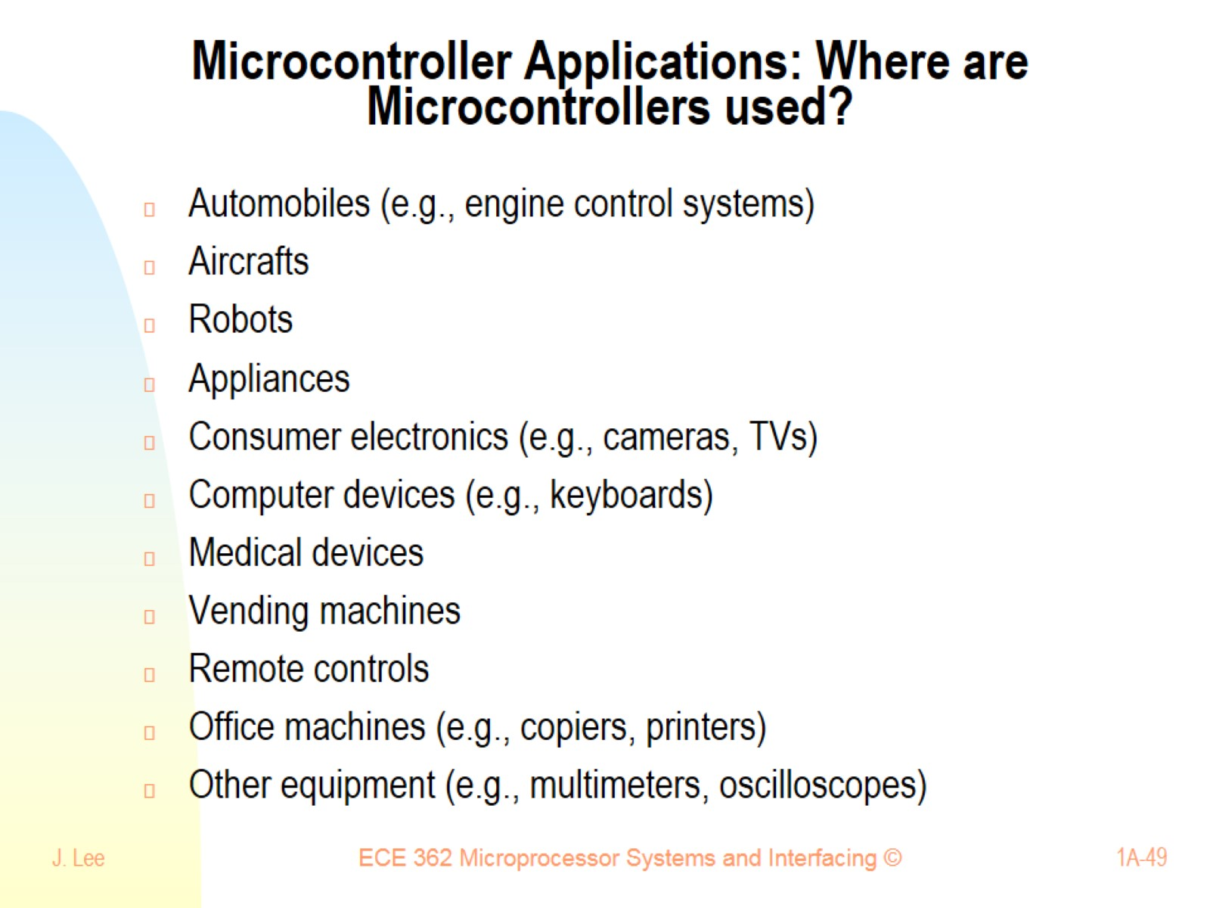
Microcontroller Applications: Where are Microcontrollers used?

Slide 50
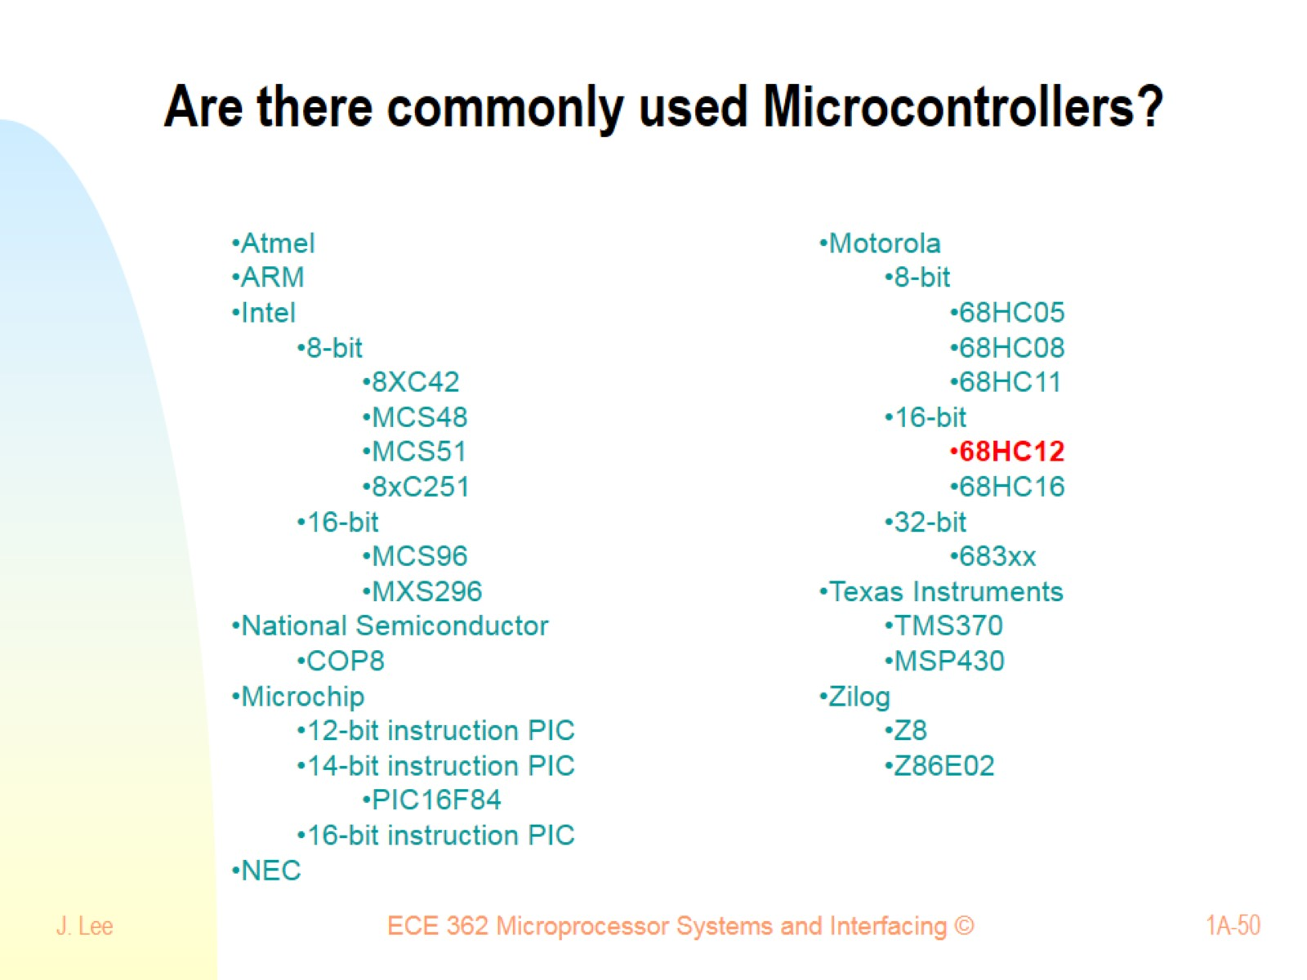
Are there commonly used Microcontrollers?

Slide 51
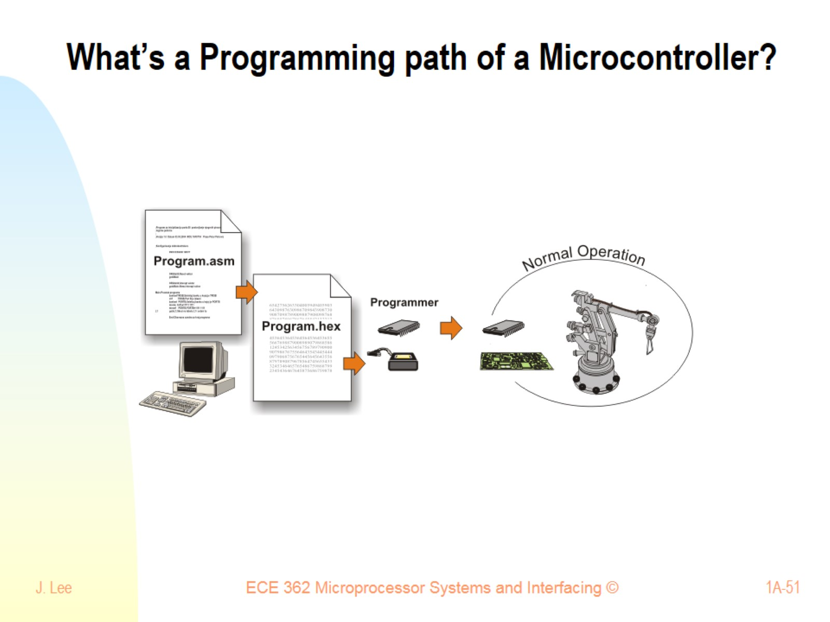
What’s a Programming path of a Microcontroller?

Slide 52

What are typical Microcontroller Properties?

Slide 53

What type of microcontroller do we use and what does it contain? Motorola 68HC12 series

Slide 54

A Typical 68HC12 Chip Pin-Layout

Slide 55

Which specific microcontroller do we use and properties?: MC9S12E128

Slide 56

MC9S12E128CPVE Chip Pin-Out

Slide 57

Are there different CPU architectures?

Slide 58

Nature of the subject

